Slide 1
NCATS and GSRS
Danny Katzel
Tyler Peryea
Noel Southall

Slide 2
What is NCATS
The National Center for Advancing Translational Sciences
One of 27 Institutes and Centers at the National Institutes of Health (NIH)
Established to transform the translational process so that new treatments and cures for disease can be delivered to patients faster.

Slide 3
NCATS and GSRS Software Development
NCATS has 4 software developers working on GSRS everyday
In constant collaboration with our FDA colleagues and other GSRS Stakeholders
NCATS drives the development of non-FDA specific GSRS features
Also helps develop FDA-specific features

Slide 4
NCATS and GSRS Software Development
How Does GSRS help NCATS “transform the translational process so that new treatments and cures for disease can be delivered to patients faster” ?

Slide 5
NCATS projects that use GSRS
Beyond providing a resource to research community that provides robust definitions of the ingredients in marketed and investigational drugs, we also use the software and data to drive the research we do at NCATS.
Inxight Drugs
Compound Registration
NCATS Pharmaceutical Collection
GARD
Translator

Slide 6
Inxight Drugs
Uses GSRS data and its web application shell to organize drug information from a research perspective at https://drugs.ncats.io/
Under the covers, this is the same ginas software and data, but
customizes the presentation of GSRS information to focus on different aspects of the data
group salts, esters into a single ‘primary’ record
integrates additional data from external sources, including manually-curated data
includes tool substances not found in regulated medical products
Notes:
Here we try and organize the same GSRS information in a slightly different way. Under the covers, this is the same ginas software, but with some changes - so the software is flexible and can be customized to suit the specific needs of an organization.

Slide 7
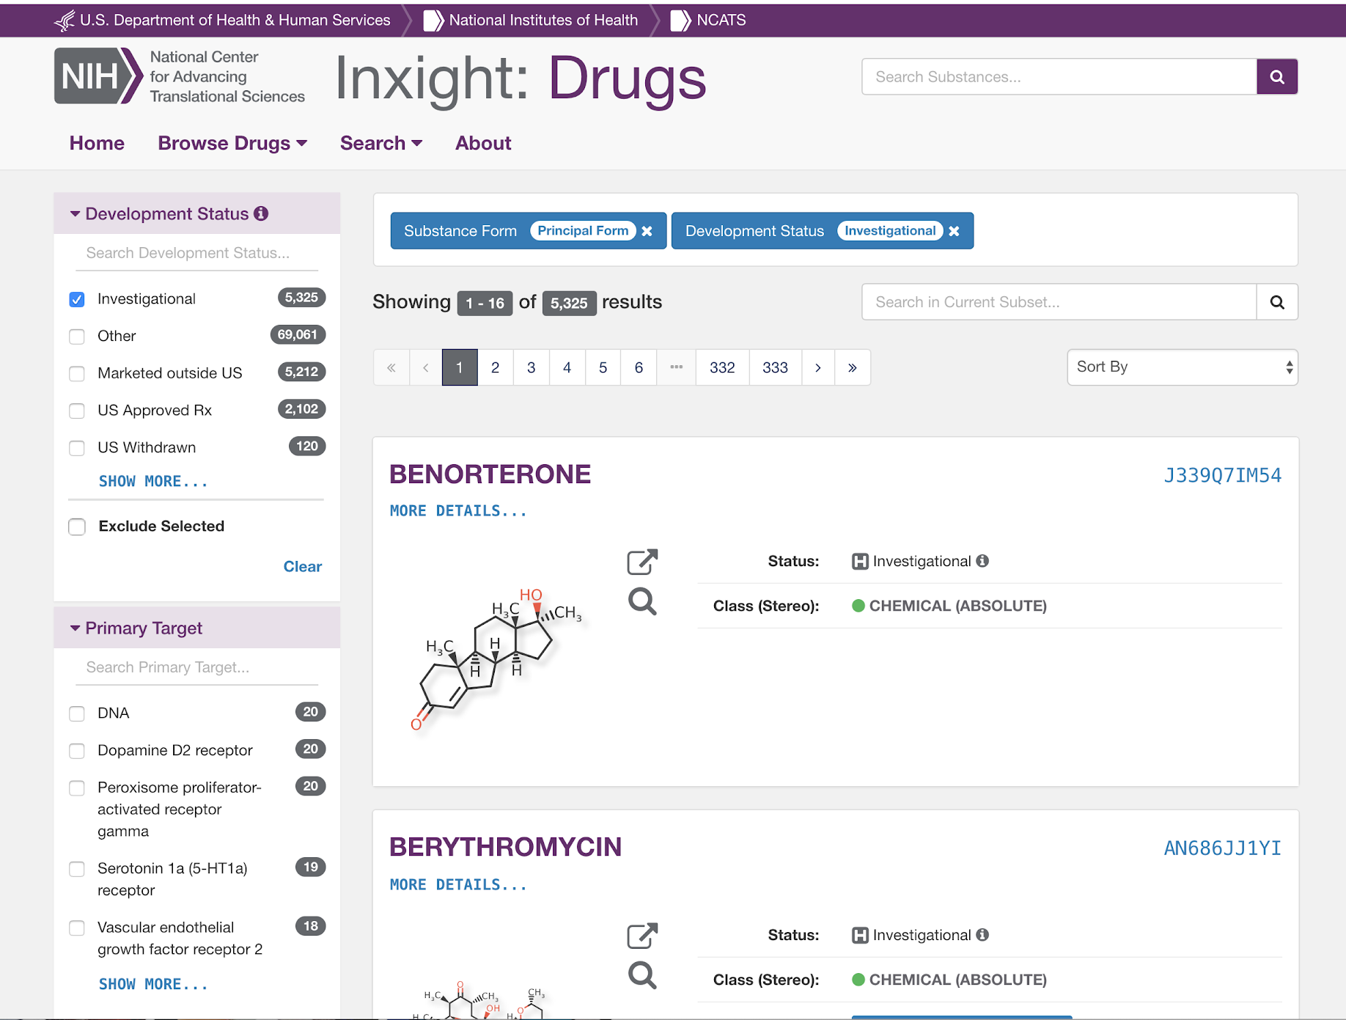
drugs.ncats.io
Customizes GSRS record layout
Integrates manually- curated data
Groups different salt forms together into a single record

Slide 8
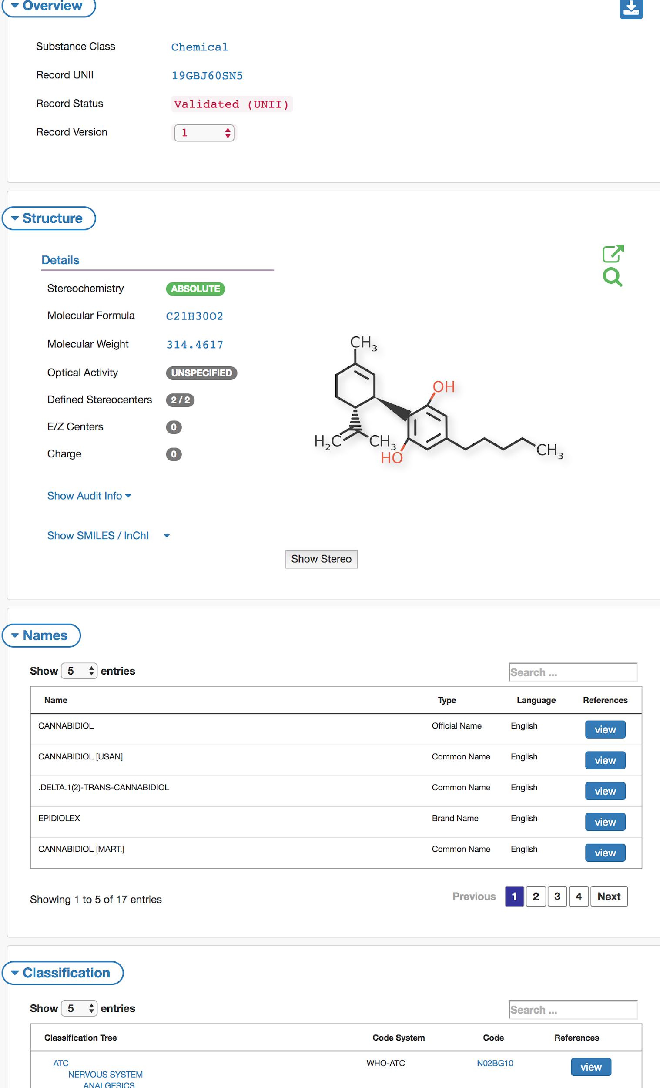
ginas.ncats.nih.gov
Regulatory perspective
Focus on structure
Names
Classifications

Slide 9
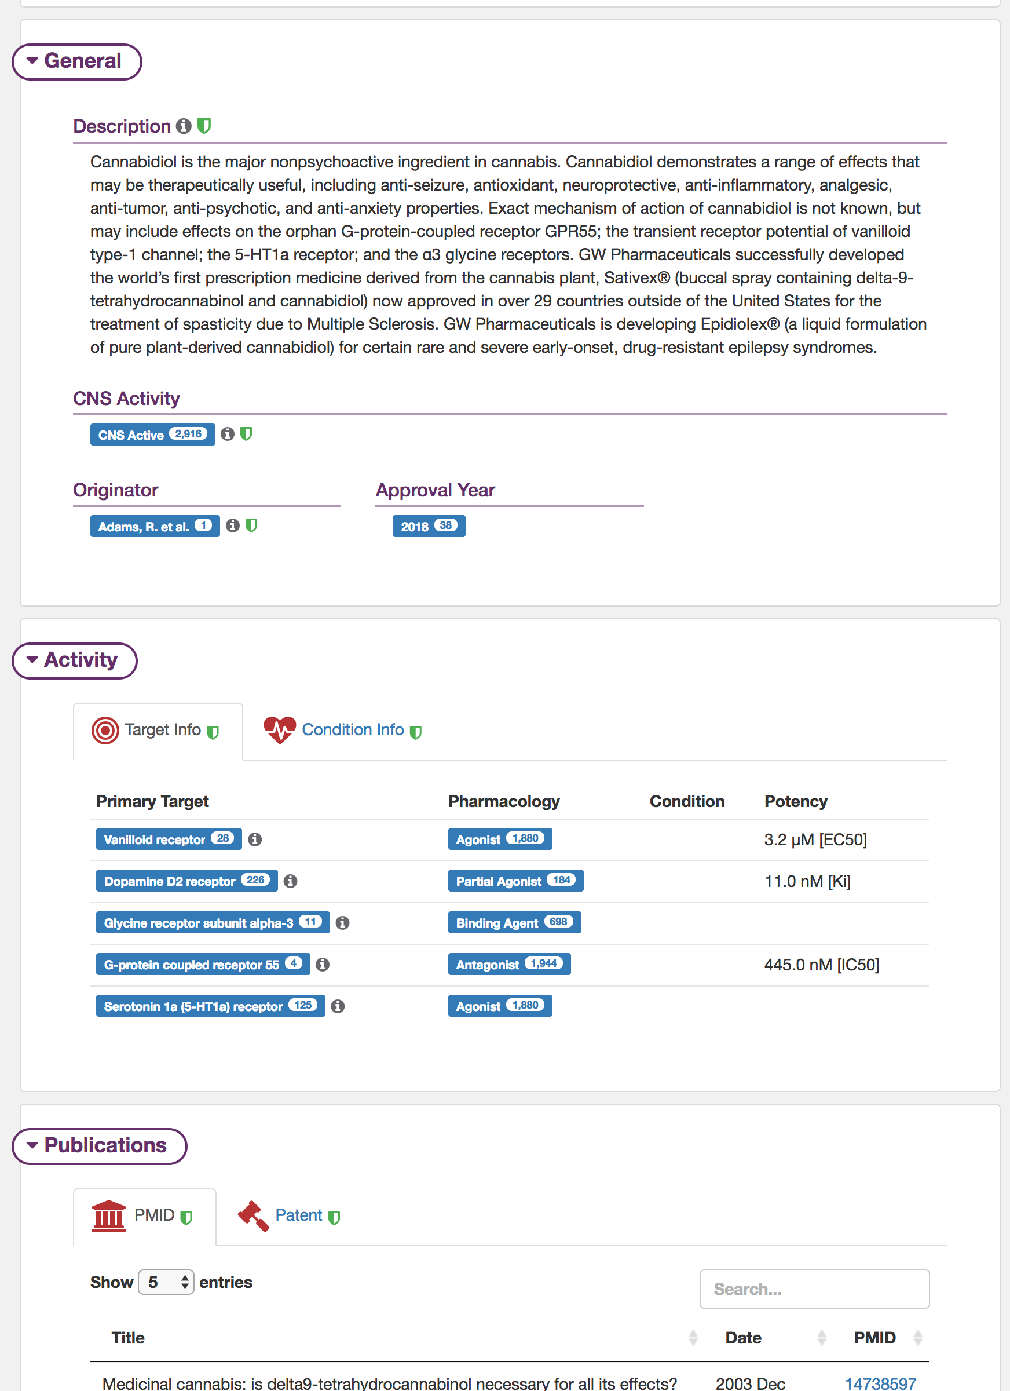
drugs.ncats.io
Focus on
Targets
Conditions
Publications
Research Uses

Slide 10
drugs.ncats.io
The important thing is that we are not polluting the GSRS data store,
Using UNII to link out to other APIs + services and integrating that other data into this web page on the fly.
Notes:
The little green shields indicate data that was manually curated by Rancho Biosciences

Slide 11
drugs.ncats.io
The Little Green shields are data that was manually curated by Rancho Biosciences
Notes:
The little green shields indicate data that was manually curated by Rancho Biosciences

Slide 12
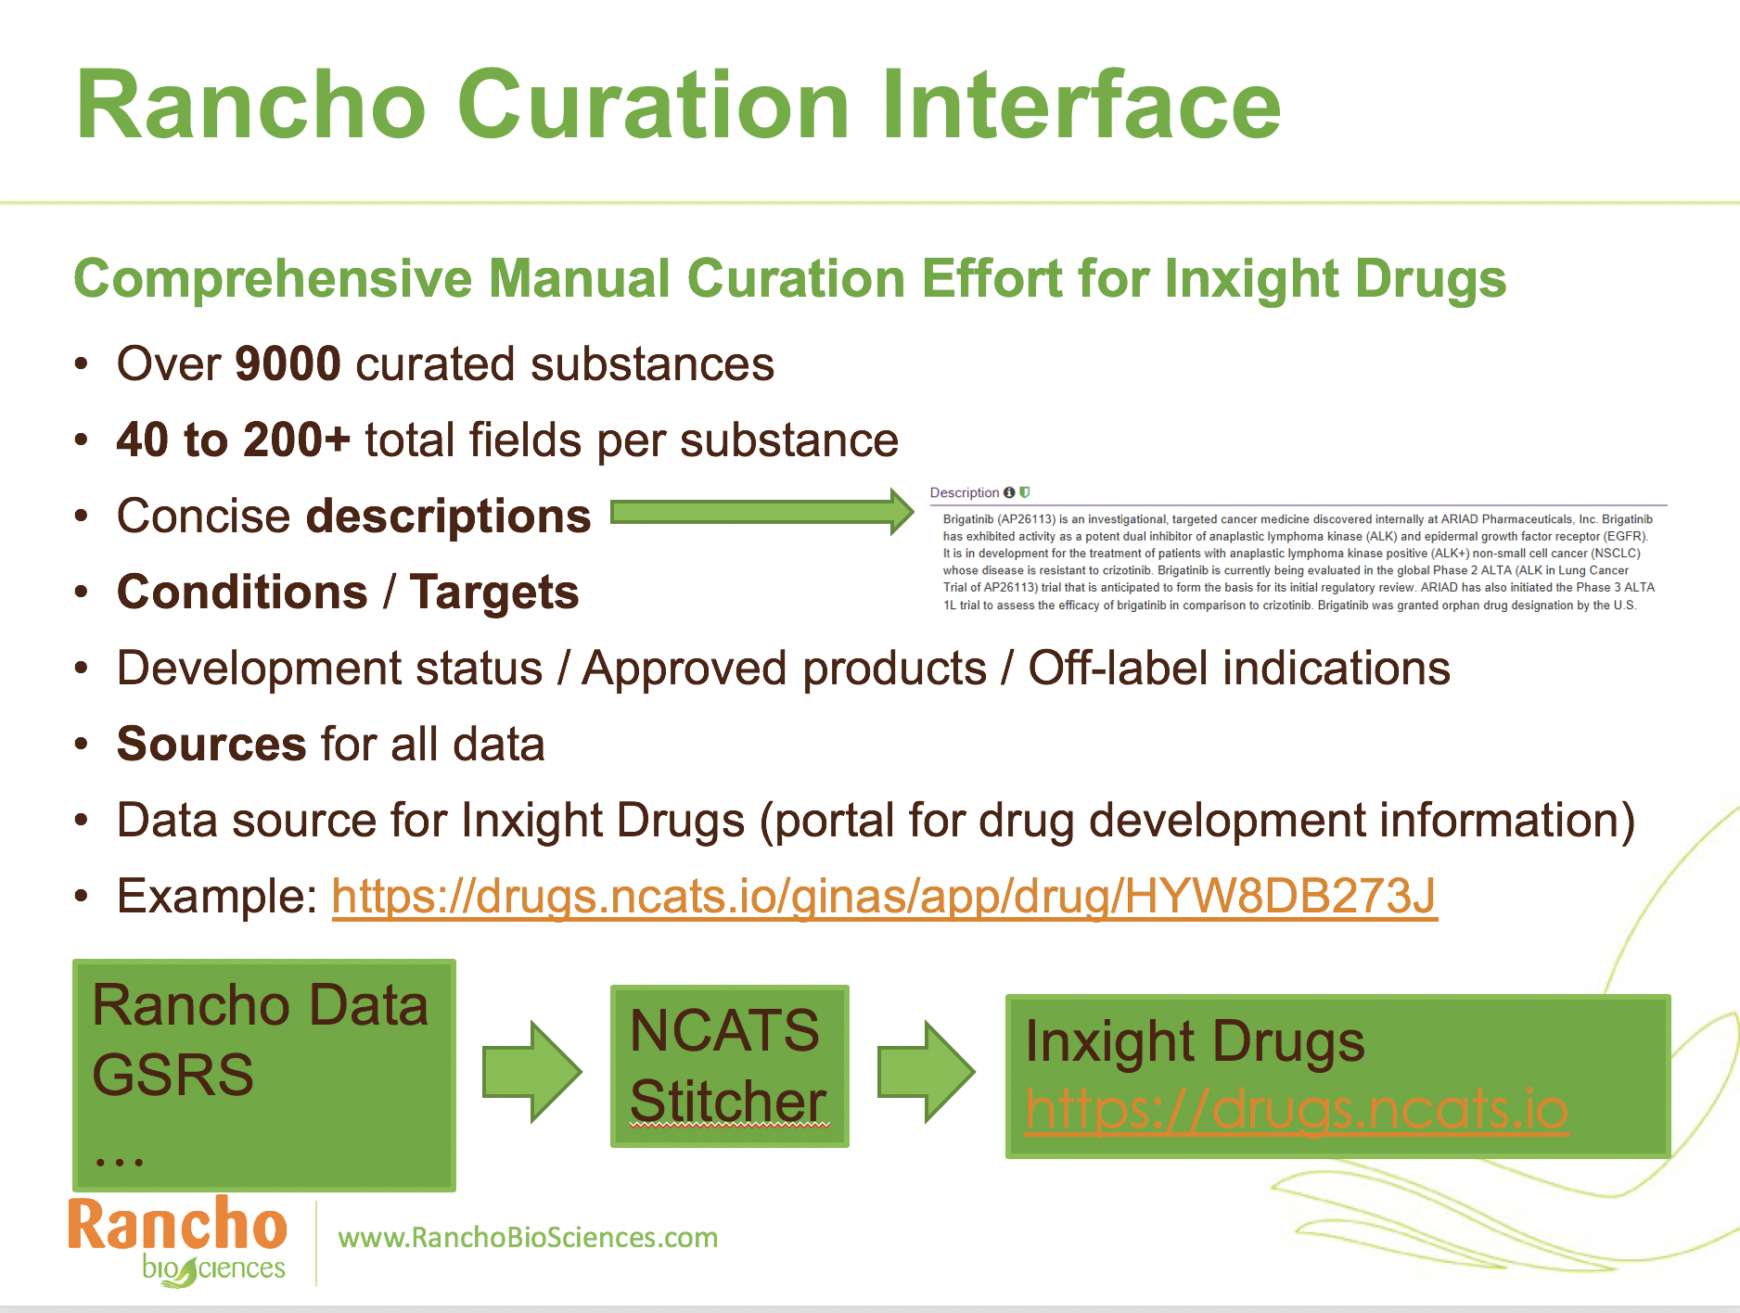

Slide 13
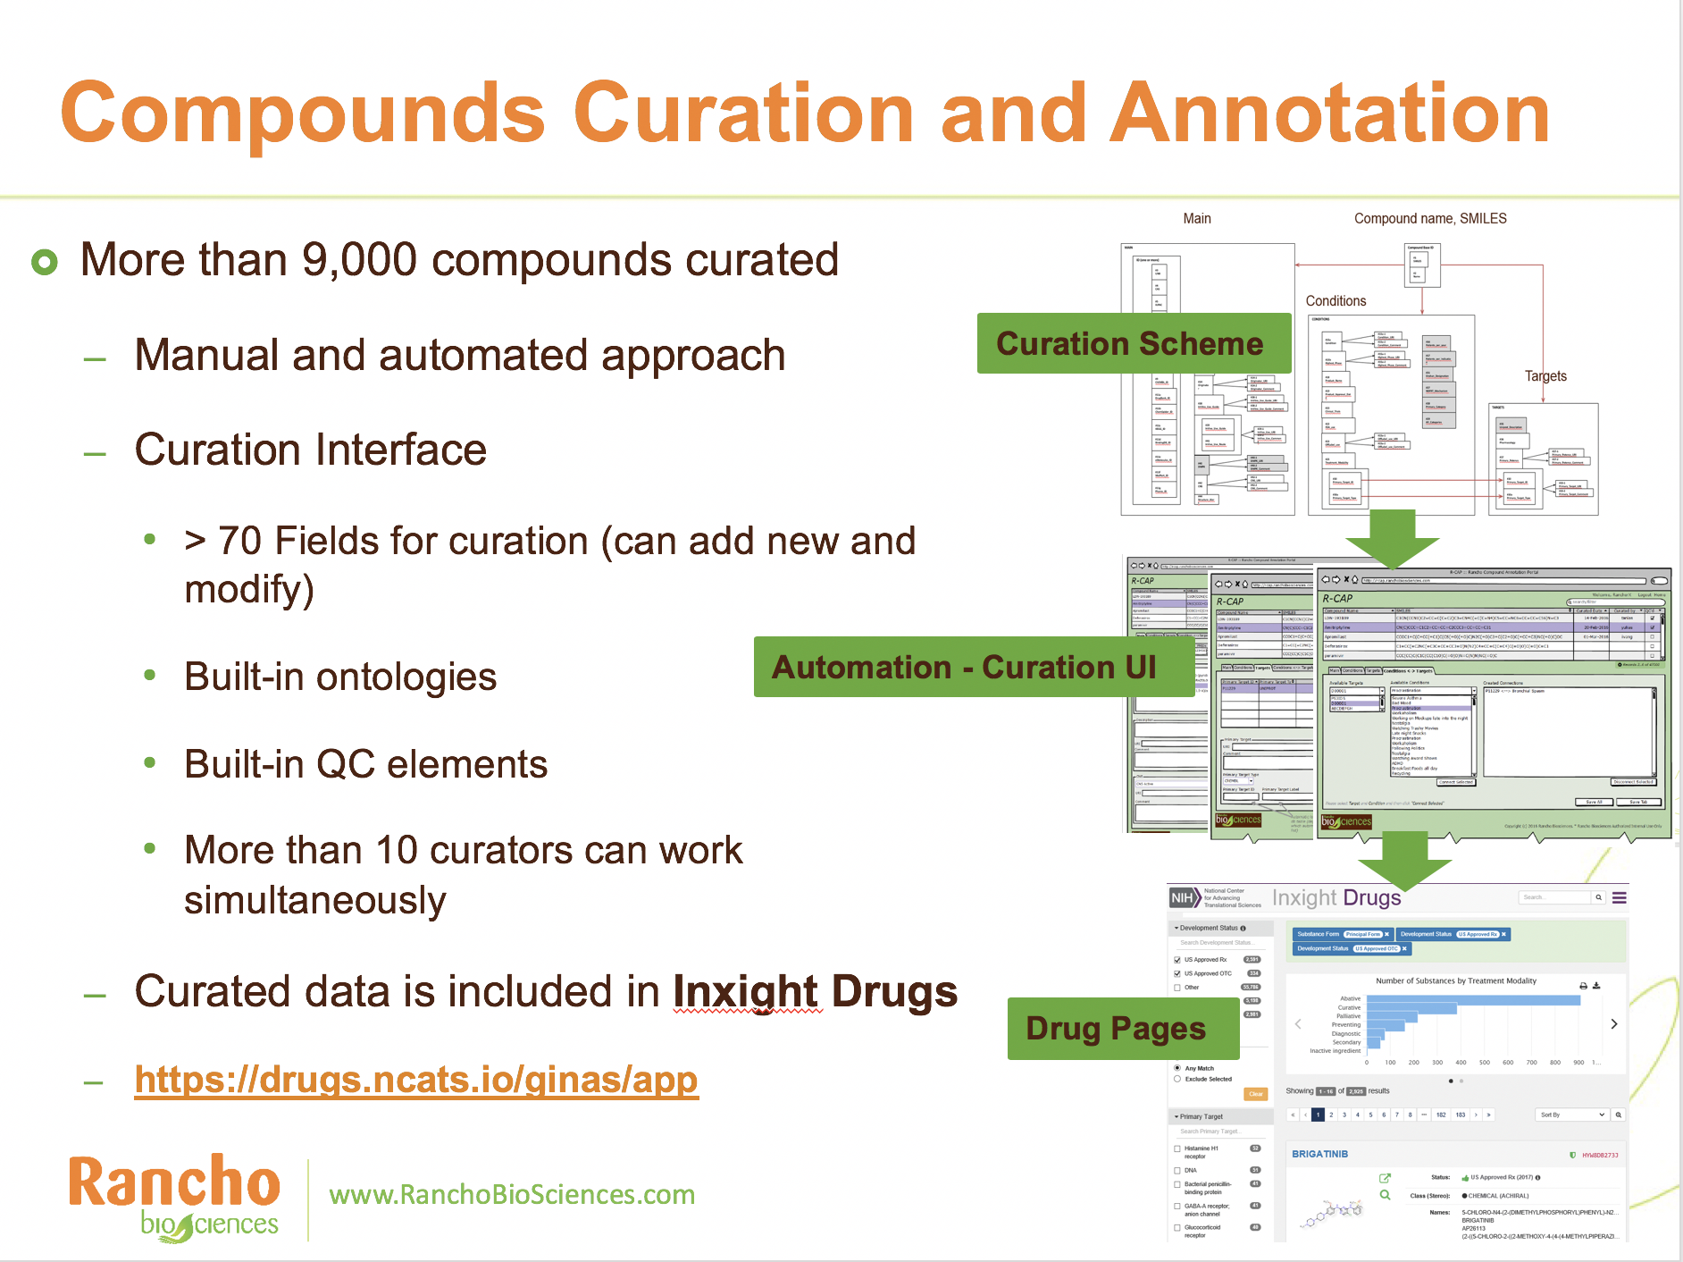

Slide 14
NCATS projects that use GSRS
Beyond providing a resource to research community that provides robust definitions of the ingredients in marketed and investigational drugs, we also use the software and data to drive the research we do at NCATS.
Inxight Drugs
Compound Registration
NCATS Pharmaceutical Collection
GARD
Translator

Slide 15
NCATS Compound Registration
Using GSRS
NCATS has screening libraries of hundreds of thousands of molecules
We have a Compound Registration System to support the high-throughput screening and medicinal chemistry activities that we do on-site.

Slide 16
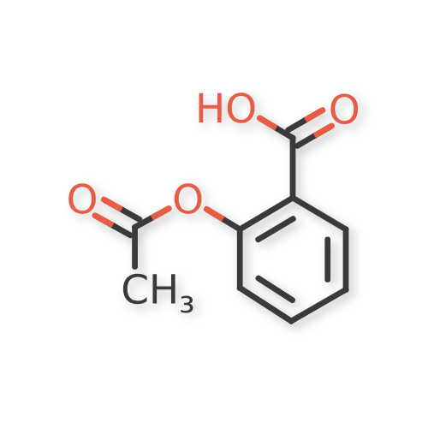
NCATS Registration Process
DB #1
There are multiple databases where compounds go
The schema is the same, but are used by different tools/resources
And have different access restrictions
Commercial Proprietary System
Chemical Structure
DB #2
ID Generation

Slide 17
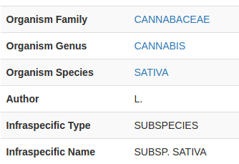
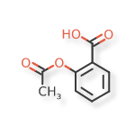
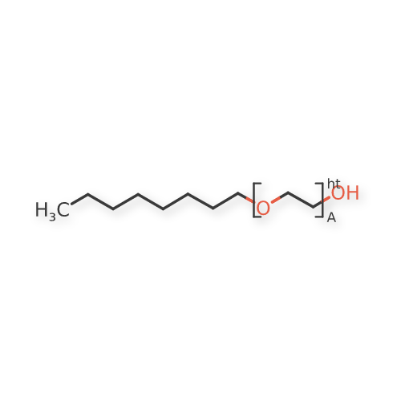
Commercial Proprietary System vs GSRS
Well-supported
in both
Ad hoc support in CPS, full support in GSRS
Substance Type | Chemical | Polymer | Protein | Nucleic Acid | Structurally Diverse
Defined By | Chemical Structure | Structural Repeat Unit(s) | Amino Acid Sequence(s) | Nucleobase Sequence | Taxonomic Information + Part
Example |  |  | >A35X00TA2K RCPGCGQGVQAGCPGGCVEEEDGGSPAEGCAEAEGCLRREGQECGVYTPNCAPGLQCHPP... | >303159CVH9 TAAACGTTATAACGTTATGACGTCAT

Slide 18
Problems with molecules in Proprietary System:
Difficulty detecting tautomers, leads to lots of IDs
Difficulty standardizing structures
Harder to implement custom rules
Harder to share best practices when we get it “right”
NCGC00015067
NCGC00090977
NCGC00254034
NCGC00259666
NCGC00260723

Slide 19
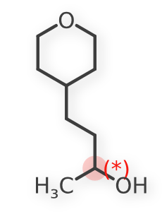
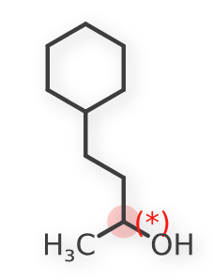
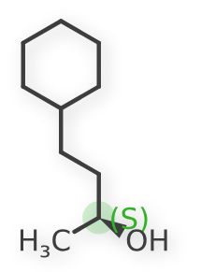
Chemical Uniqueness: Lychi
NM5XP8H4S-SDPWZ6K334-S43K36K4U7A-S4ASJYA6M4HZ
NM5XP8H4S-SR4FWULG2K-SKT4316BJM5-SK5PGZ7BHWRU
NM5XP8H4S-SR4FWULG2K-SKT4316BJM5-SK5GNTMFYY2N

Slide 20
Legacy NCATS Registration Process
DB #1
Commercial Proprietary System
Chemical Structure
DB #2
ID Generation

Slide 21
Future NCATS Registration Process
or
DB #1
RCPGCGQGVQ AGCPGGCVEE EDGGSPAEGC AEAEGCLRRE GQECGVYTPN CAPGLQCHPP ...
Substance Definition
GSRS Format
GSRS
DB #2
ID Generation

Slide 22
NCATS projects that use GSRS
Beyond providing a resource to research community that provides robust definitions of the ingredients in marketed and investigational drugs, we also use the software and data to drive the research we do at NCATS.
Inxight Drugs
Compound Registration
NCATS Pharmaceutical Collection
GARD
Translator

Slide 23
NCATS Pharmaceutical Collection
We've also used the GSRS information to help us build a physical collection of the approved drugs for repurposing screens.
A comprehensive, publicly accessible collection of approved and investigational molecular entities for high-throughput screening
provides a valuable resource for both validating new models of disease and better understanding the molecular basis of diseases and interventions.
Nearly 2,750 small molecular entities have been approved for clinical use by U.S., European Union, Japanese and Canadian authorities and also are suitable for high-throughput screening. Of these, NCATS currently has 2,500, along with about 1,000 additional investigational compounds, as part of its screening collection.
https://ncats.nih.gov/expertise/preclinical/npc

Slide 24
The collection already has generated several useful probes for studying a diverse cross section of biology, including novel targets and pathways.
NCATS provides access to the collection’s content through the Therapeutics for Rare and Neglected Diseases program (TRND) and the Toxicology in the 21st Century initiative (Tox21).
A dedicated online browser enables searching and exporting. NCATS makes regular updates to the browser to improve features and content.
The publication about this work remains the most cited paper from NCATS
https://ncats.nih.gov/expertise/preclinical/npc

Slide 25
How is GSRS used
GSRS data is used to see what approved drugs are missing from our screening library
Do we have the “right” structure for our substance?
How does our structure compare to what GSRS thinks is the correct structure.
https://ncats.nih.gov/expertise/preclinical/npc

Slide 26
NCATS projects that use GSRS
Beyond providing a resource to research community that provides robust definitions of the ingredients in marketed and investigational drugs, we also use the software and data to drive the research we do at NCATS.
Inxight Drugs
Compound Registration
NCATS Pharmaceutical Collection
GARD
Translator

Slide 27
Genetic and Rare Disease Information Center
NCATS' most important public website is actually not for research scientists, but for patients.
It brings 10x the traffic of all of our other resources combined.
Nearly 1 in 10 Americans has a rare disease diagnosis, and for many, their first online encounter with disease information is through the clearing houses of disease information that NIH provides.
NCATS is working with GARD to organize their information on rare diseases and treatments, using GSRS to structure their content databases.
https://rarediseases.info.nih.gov/

Slide 28
Genetic and Rare Disease Information Center
Our goal is to both provide patients with the most up-to-date information, but also structure the data for research use programmatically. For many rare diseases, there are no products specifically approved to treat that disease, but physicians deploy treatments to address the needs of their patients as best they can. Understanding the evolution of medical practice is critical to helping the most patients we possibly can as well as giving research scientists the information they need to identify and address unmet needs.
https://rarediseases.info.nih.gov/

Slide 29
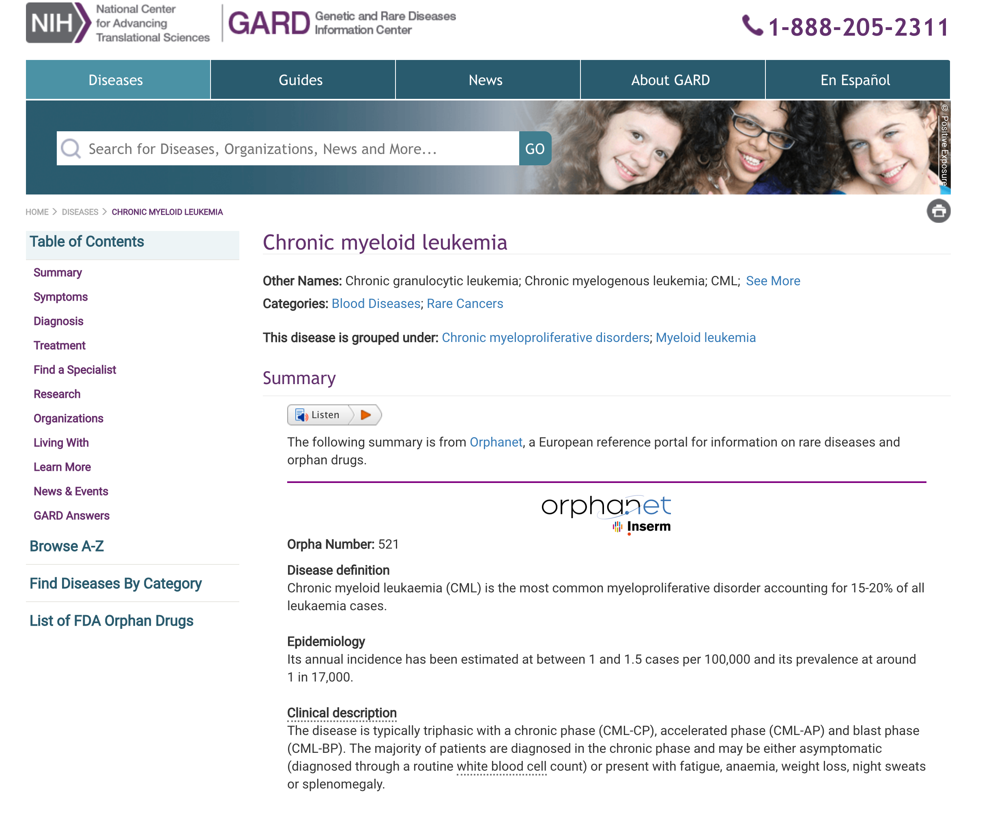

Slide 30
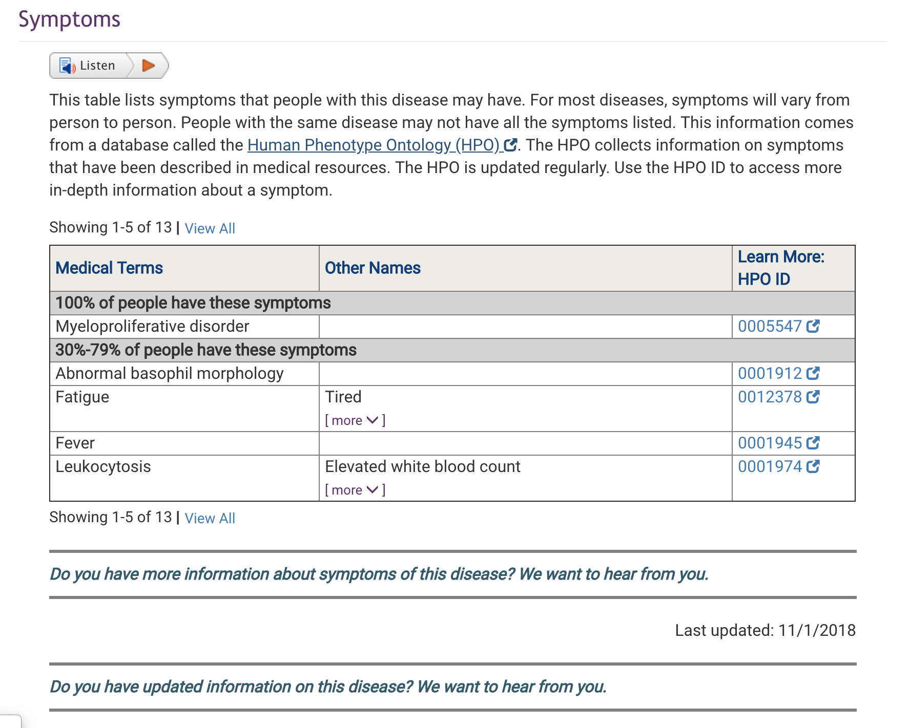

Slide 31
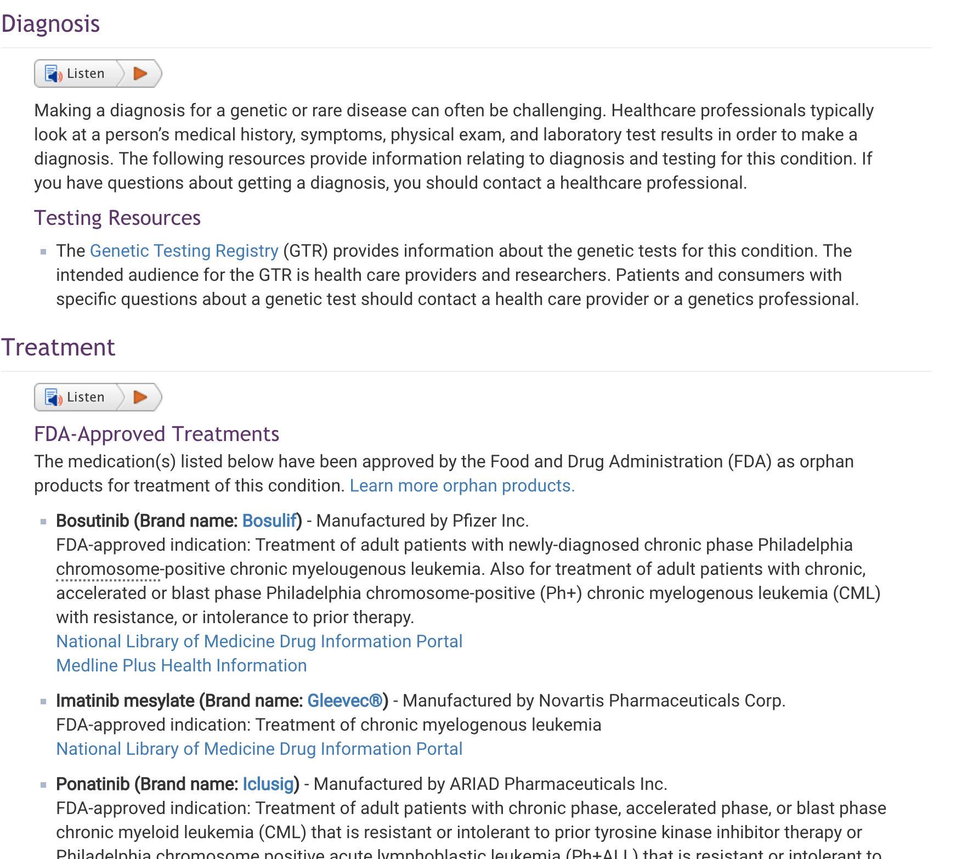

Slide 32
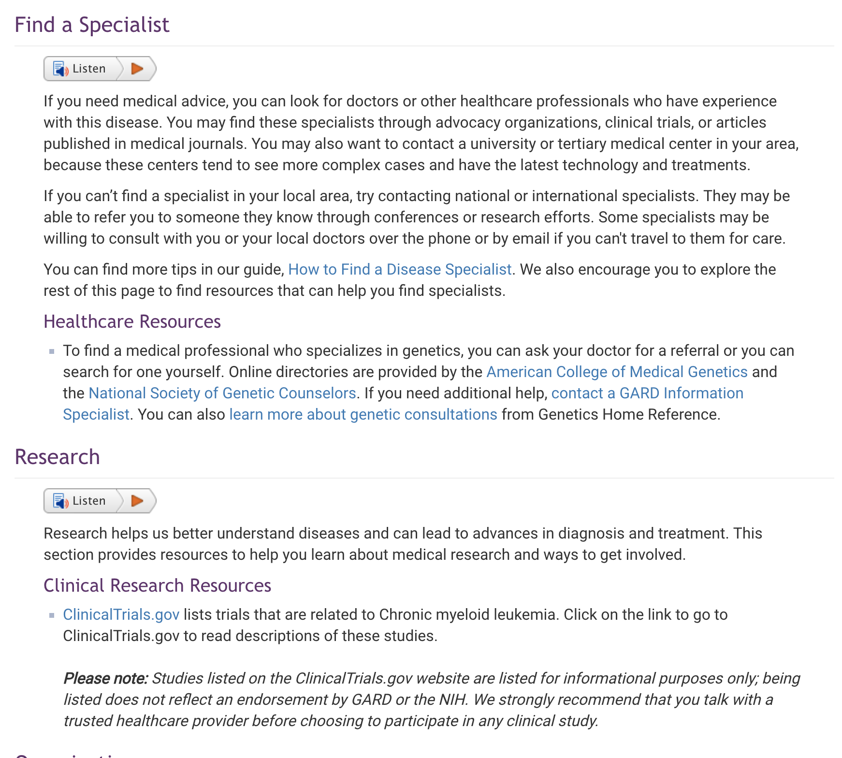

Slide 33
Right now most of the GARD data is manually entered
Using GSRS for its standardized data to help make the system updates more automated /programmatic

Slide 34
NCATS projects that use GSRS
Beyond providing a resource to research community that provides robust definitions of the ingredients in marketed and investigational drugs, we also use the software and data to drive the research we do at NCATS.
Inxight Drugs
Compound Registration
NCATS Pharmaceutical Collection
GARD
Translator

Slide 35
NCATS Biomedical Data Translator
A research program that is designed to reduce significant barriers between research discovery and clinical trials, in part by organizing the copious amounts of research data currently available.
Working with more than 19 research labs around the country that specialize in biomedical data infrastructure, we are defining a system for helping research scientists work together with data. This initiative is currently in a feasibility testing phase - defining three aspects of what a future system must do.
Notes:
#2 - one project we have is bringing environmental exposure data in to the clustering and analysis of asthma patient data from electronic health records, looking at how we can integrate geospatial data into sensitive data like medical records to further research goals.

Slide 36
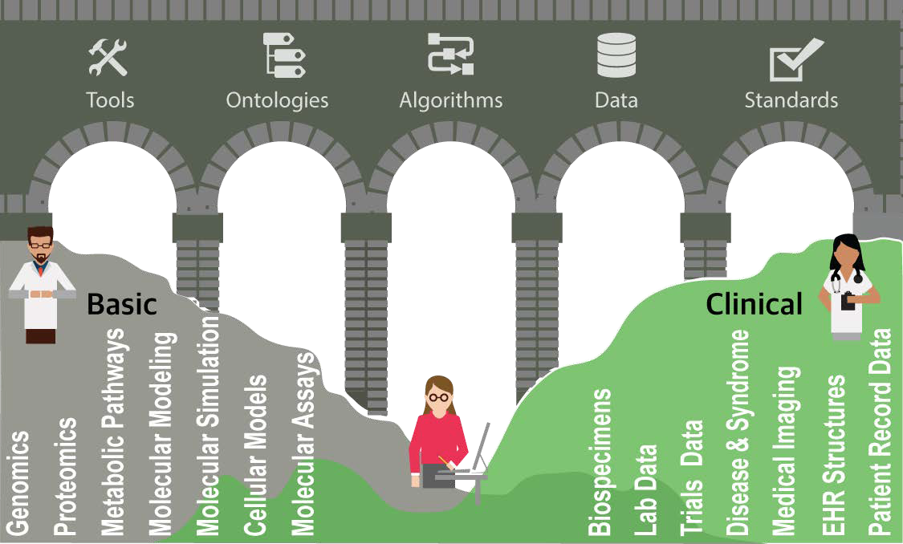
Crossing the chasm of semantic despair
Figure courtesy of Julie McMurry & Chris Mungall
Notes:
There is an enormous infrastructure (pipes) needed to be able to do this in practice. Some of that infrastructure already exists, but needs to improved / tailored. Other components that could bridge clinical and basic research are missing completely.
If we could make better sense of the vast data we already have, we can unlock how to better treat disease - and make really exciting connections between diseases.
We've already seen the potential connections that can be made first-hand in some of the development projects we've worked on --- developing new approaches to neurodegeneration for example --- how do we systematize this and change the way we find new medicines and practice medicine?
There are some technical challenges – Clinicians and biologists think of disease in different ways, and speak different languages
Physicians diagnose and treat disease based on signs and symptoms affecting specific target organs
Biomedical researchers think of disease in terms of molecular changes in specific proteins, pathways or cell types
And there are some difficult scientific challenges - that advances in artificial intelligence and deep learning might be very useful in solving.

Slide 37
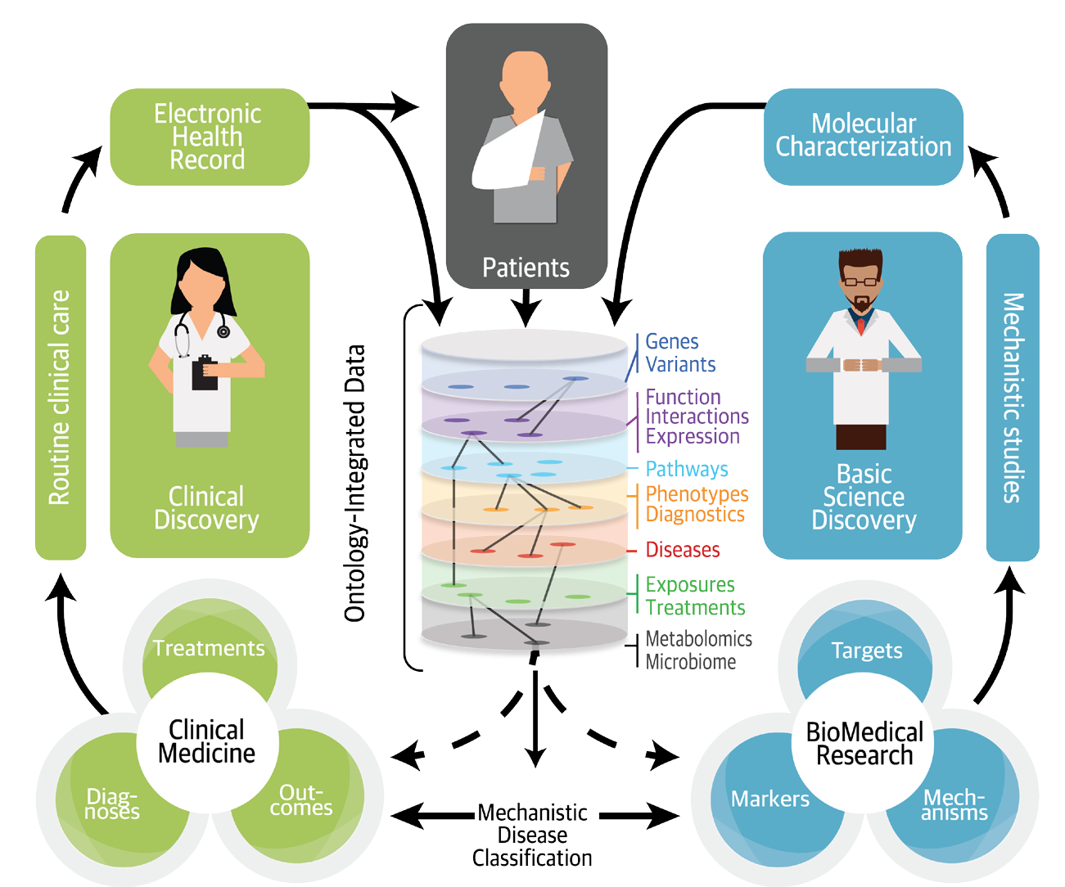
Figure courtesy of Julie McMurry & Chris Mungall
Notes:
Our view is that deep integration of research and clinical resources will permit a molecularly-driven, virtuous cycle of continuous care improvement and new product development.
And it is important to support this as product development, as opposed to traditional research and analysis projects – we need researchers iterating through cycles of improvement with practitioners to deliver improved tools.

Slide 38
Biomedical Data Translator
Novel data integration
Environment/patient health
Molecular/phenotype/disease
Drugs/adverse events
Novel analytic capability
Data-driven modeling
Probabilistic graphical modeling
Notes:
The program focuses in 2 key areas to demonstrate the feasibility of new approaches: novel types of data integration and novel ways of analyzing the enormous quantity of available data.
We’ve built a program together with 16? 19? other research groups outside of NIH to address these technical, scientific, and especially the social engineering challenges of data sharing, to establish the feasibility of building out a new kind of clinical research infrastructure.
1) define how to identify and share data, especially facilitating the adoption of ontologies and data standards like ISO 11238 and GSRS
2) demonstrate novel types of data integration
3) layering novel analytic capacity on top of these data. If we can structure the data, we can leverage advances in computing power and ways of mining that data to identify new ideas and hypothesis about medicine.

Slide 39
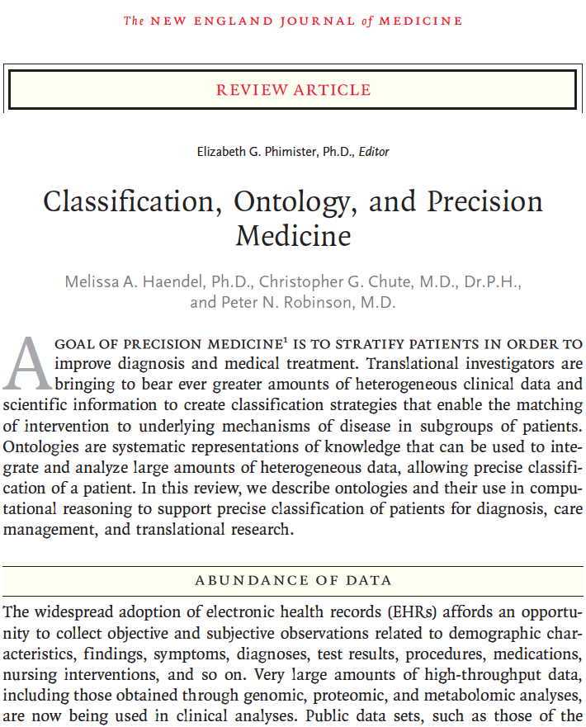
Biomedical Data Translator
Novel data integration
Environment/patient health
Molecular/phenotype/disease
Drugs/adverse events
Novel analytic capability
Data-driven modeling
Probabilistic graphical modeling
October 11, 2018 N Engl J Med 2018; 379:1452-1462
Notes:
And now the first publications are coming out from this work, including important recent papers in NEJM

Slide 40
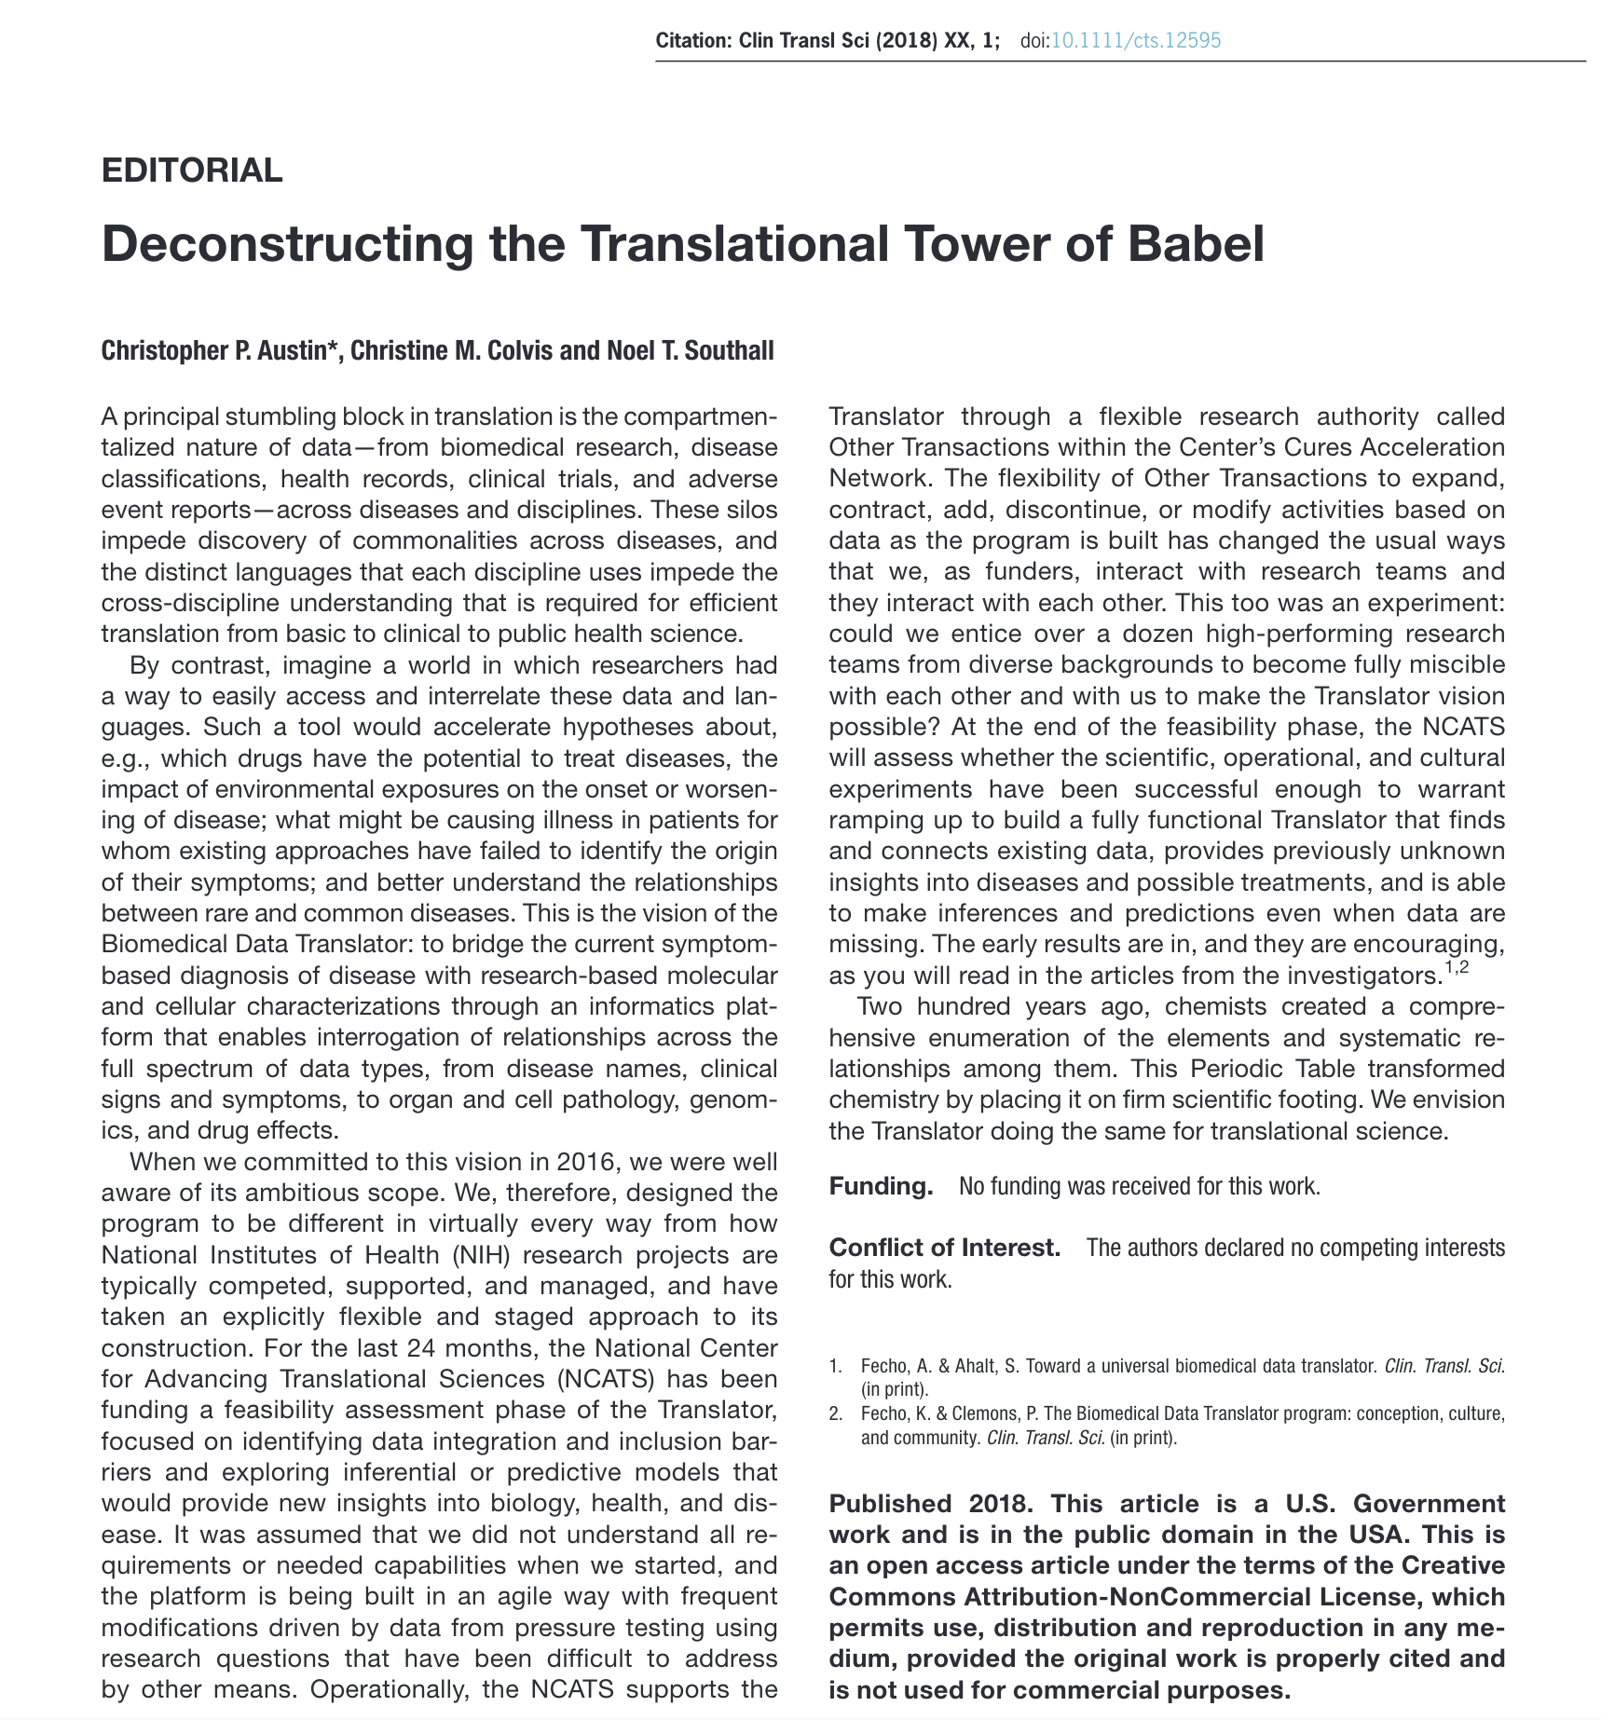

Biomedical Data Translator
Novel data integration
Environment/patient health
Molecular/phenotype/disease
Drugs/adverse events
Novel analytic capability
Data-driven modeling
Probabilistic graphical modeling
November 9, 2018 Clin Transl Sci 10.1111/cts.12595
Notes:
And now the first publications are coming out from this work, including the recent editorial in clinical translational sciences from just this past week

Slide 41

Notes:
In summary, from my translational perspective, I see change coming: connecting advances in understanding molecular pathophysiology through to clinical presentation; grounding routine clinical practice to the enormous foundation of knowledge currently available. We’ve made an incredible investment and generated a phenomenal amount of data on the molecular basis of disease, and this will bring about changes in how we define, diagnose and treat disease. Already this is a cornerstone of new product development, and there are opportunities to enhance the change of existing clinical practices as well.
The integration of additional non-clinical data – environmental, social, personal data clouds, etc. – can obviously be used to better understand the drivers of signs and symptoms that patients presents with, and alter how that patient is treated.
And this is important because the reality is that the current diagnosis process is poor, and we have powerful tools in the current pharmacopeia that are far from being optimally deployed.

Slide 42
Conclusion
Our collaboration with FDA on implementing ISO 11238 for regulatory and research use has been a fantastic success for NCATS, in advancing our research mission!
… and we hope it will be helpful advancing your own organizational goals as well.

Slide 43
Acknowledgements
NCATS
Tyler Peryea
Noel Southall
Dac-Trung Nguyen
Ivan Grishagin
Dammika Amugoda
Jorge Neyra
Niko Anderson
Mark Williams
Tim Sheils
Chris LeClair
Paul Shinn
Qian Zhu
Christine Colvis
Mark Williams
FDA
Larry Callahan
Frank Switzer
Yulia Borodina
Ramez Ghazzaoui
Elaine Johansen
Ta-Jen Chen
Archana Newatia
Mary-Ann Slack
Alex Welsch
Sarah Stemann
Yoshiyuki Tokiwa
Lavanya Balabhadra
Rancho Biosciences
Laura Brovold
Yulia Skovpen
Medicines Evaluation Board
Herman Diederik Ciska Matai
Marcel Hoefnagel Burt Kroes
Joris Kampmeijer
US Pharmacopeial
Convention
Fouad Atouf
Andrej Wilk
Tina Morris
Federal Institute for Drugs and Medical Devices(Germany)
Thomas Balzer
Uppsala Montintoring Centre/ WHO
Malin Jakobsson
Health Canada
Vikesh Srivastava
SwissMedic
Philipp Weyermann
European Medicines Agency
Paolo Alcini Telonis Pangiotis
Sabine Brosch Llaria Del Seppia
Dow Corning
Katherine Ulman
Royal Botanic Gardens, Kew (UK)
Bob Allkin Elizabeth Dauncey

Slide 44
EXTRA SLIDES

Slide 47
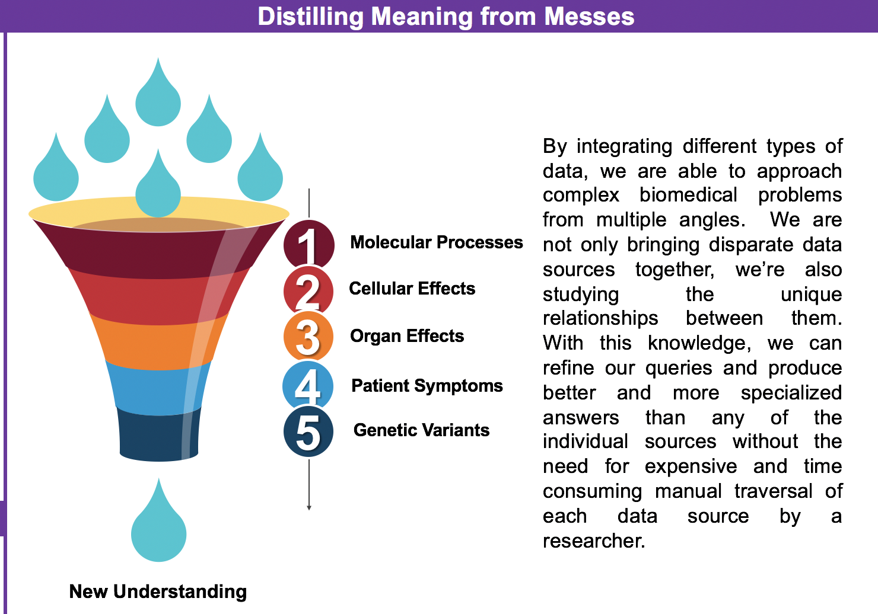

Slide 48
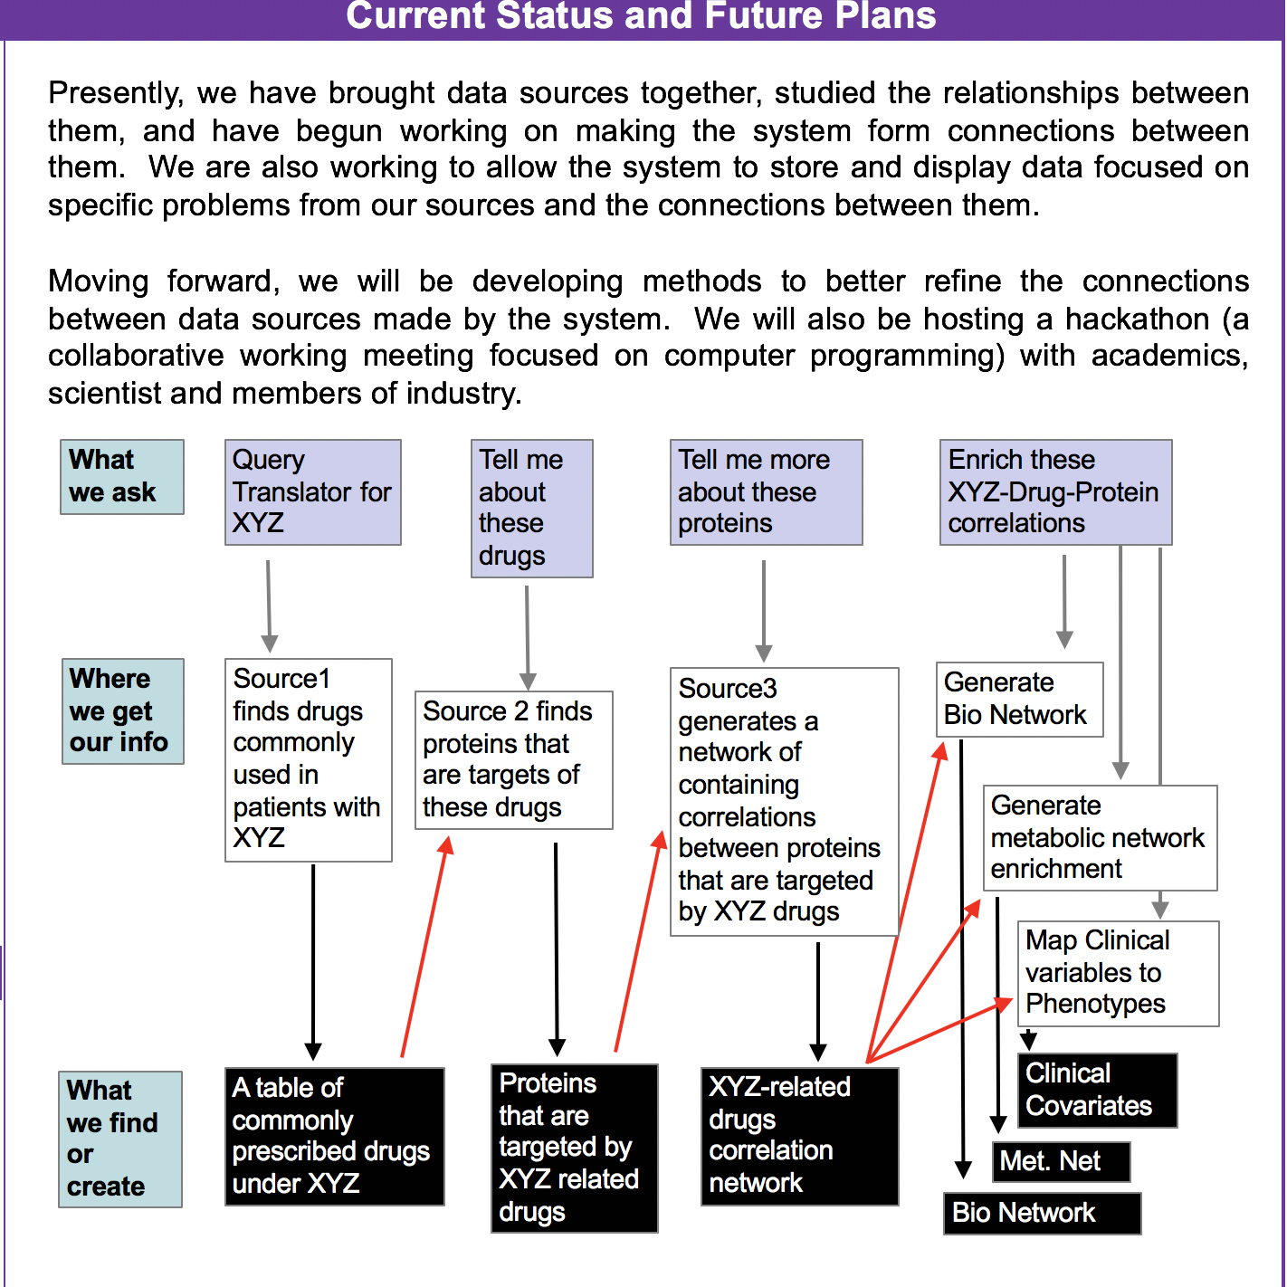

Slide 49
GSRS Features
Assign Unique Identifiers for Substances
Maintain list of synonyms for each substance across different languages
Store other text metadata descriptions, alternate IDs and codes
Store chemical structure
Find Data
Support complex searches by names and/or metadata
Support structure searches
Support sequence similarity searches
Support Regulation Lifecycle

Slide 50
NCATS Registration Process
Commercial Proprietary System
Unique
00015067-01
DB #1
Uniqueness
Non-Unique
00015067-02
Chemical Structure
Unique
00015999-01
DB #2
Uniqueness
Non-Unique
00015999-02
ID Generation

Slide 51
Compound Registration Workflow
Acquisition
Ownership
Registration
Management
Visualization
Internal Sources
NCGC
ChemTech
ADST
TRND
NCGC
GSRS System
Tool #1
ChemTech
NCGC ID
DB #1
Tool #2
ADST
Tool #3
External Sources
Collaborator
CRO
Vendor
TRND
TRND ID
DB #2
Tool #4
Notes:
Use GSRS’s access control to manage who sees what
All visualization tools only have to talk to GSRS instead of multiple systems/schemas

Slide 52
Compound Registration Workflow
Acquisition
Ownership
Registration
Management
Visualization
Internal Sources
NCGC
ChemTech
ADST
TRND
NCGC
Tool #1
ChemTech
NCGC ID
DB #1
Tool #2
ADST
Tool #3
External Sources
Collaborator
CRO
Vendor
TRND
TRND ID
DB #2
Tool #4
Notes:
Note each of the tools must know how to talk to each of the different databases. In reality not all tools know how meaning not all analyses can be run on both datasets

Slide 53
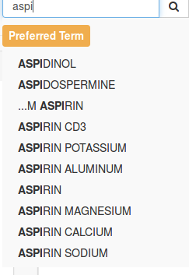
GSRS Text Search

Slide 54
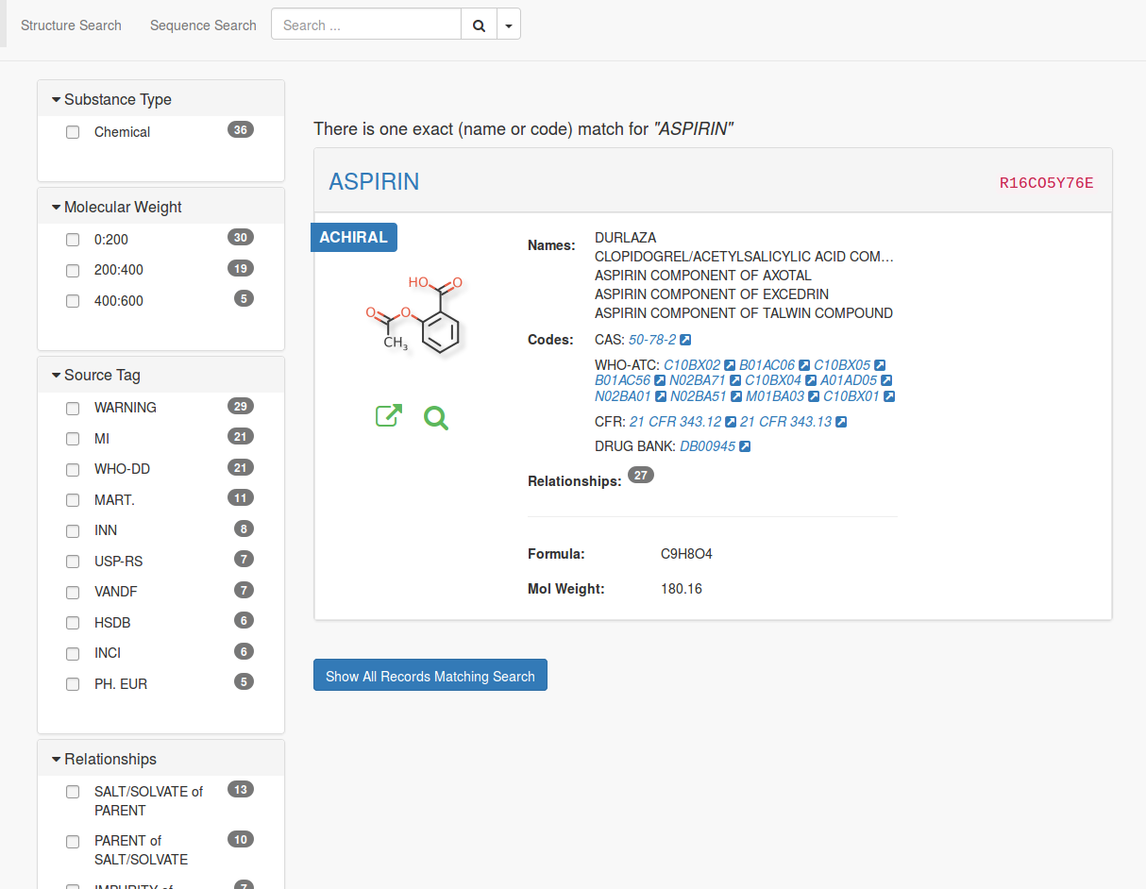
Browse

Slide 55
Browse
Facets

Slide 56
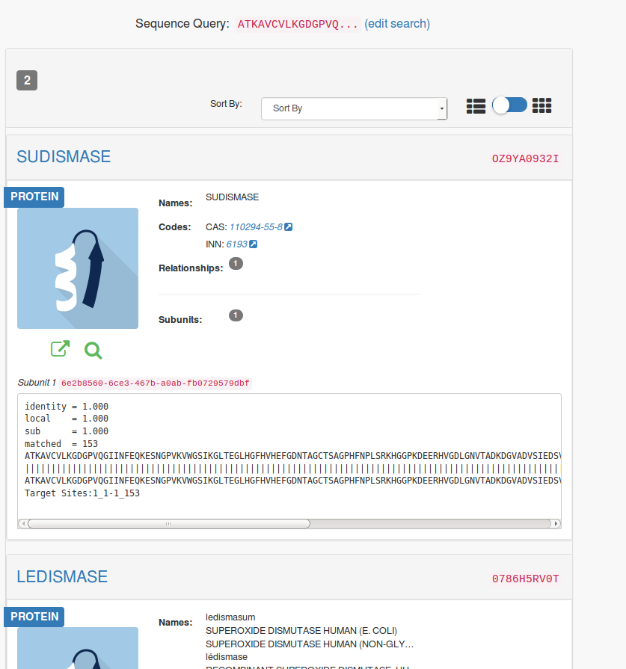
S
Sequence Search

Slide 57
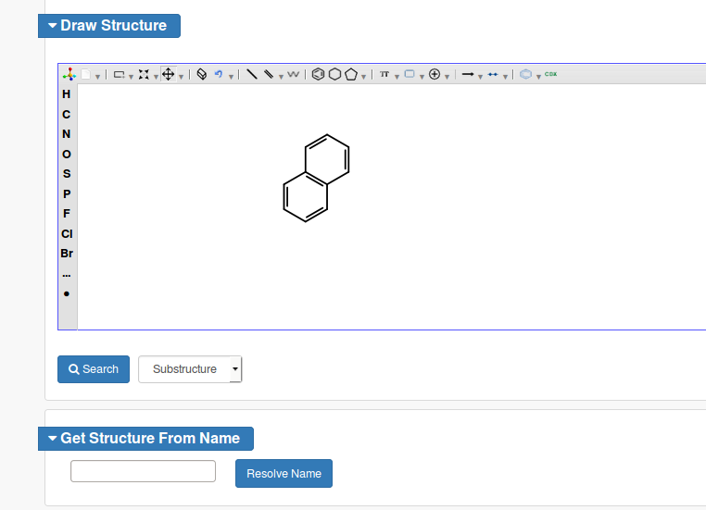
Substructure Search

Slide 58
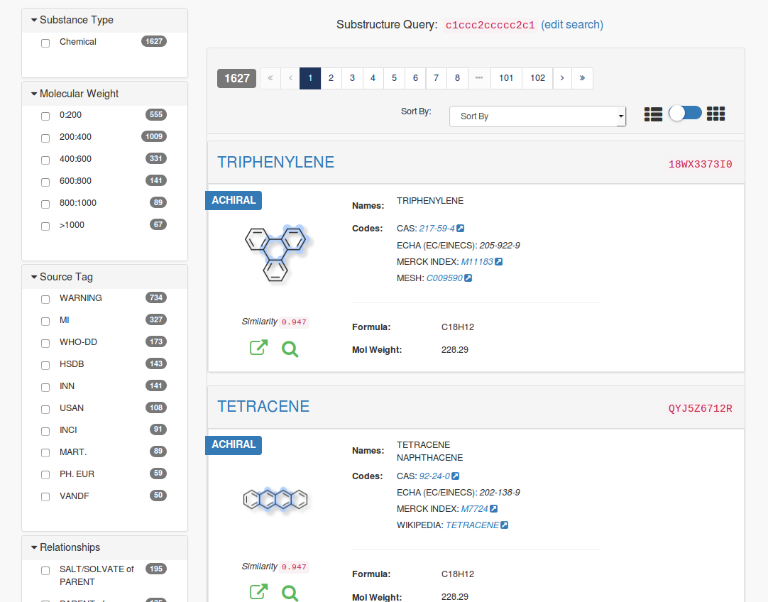

Slide 59
Browser Add-on Demo

Slide 60
GSRS Challenges
No Unit Tests in 2015
Working with FDA on their version
FDA has extra proprietary data and additional Databases we don’t have access too
FDA wants to integrate their searches against this extra data
Can’t Test Data ourselves
FDA developers work remotely
FDA Release and Deploy
FDA not only adds their own code to interact with their systems, but they change our code as well.
Code is in separate Git Branch - Code was merged a few times a year causing “merge hell” that took days sometimes weeks to resolve.
Manually built code on developer’s Windows machine sent to unix server team to deploy.
Sometimes manually built code contained files that weren’t committed!

Slide 61
Challenge Accepted
Automated Testing
Wrote 1100+ automated tests (and counting)
Set up Jenkins Continuous Integration (CI) to test and deploy instances
FDA Merge Problems
A Junior FDA developer works at NCATS with us 2x/week
New Merge Branch where both NCATS and FDA developers push changes to nearly every day. This has eliminated “merge Hell”
FDA now builds and deploys directly from git code checkout.
Refactored code to change class and interface designs to a Plugin-in architecture so that FDA changes would touch NCATS code as little as possible.

Slide 62
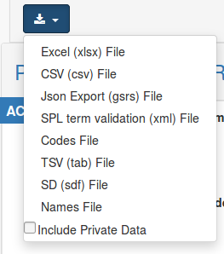
Plugable Exports to save search information
Simple Exporter interface to implement with 1 method
Corresponding Factory class to create instances and provide parameter options
Add class names to config file for ginas to find it FDA DEVELOPERS HAVE WRITTEN THEIR OWN CUSTOM EXPORTERS

Slide 63
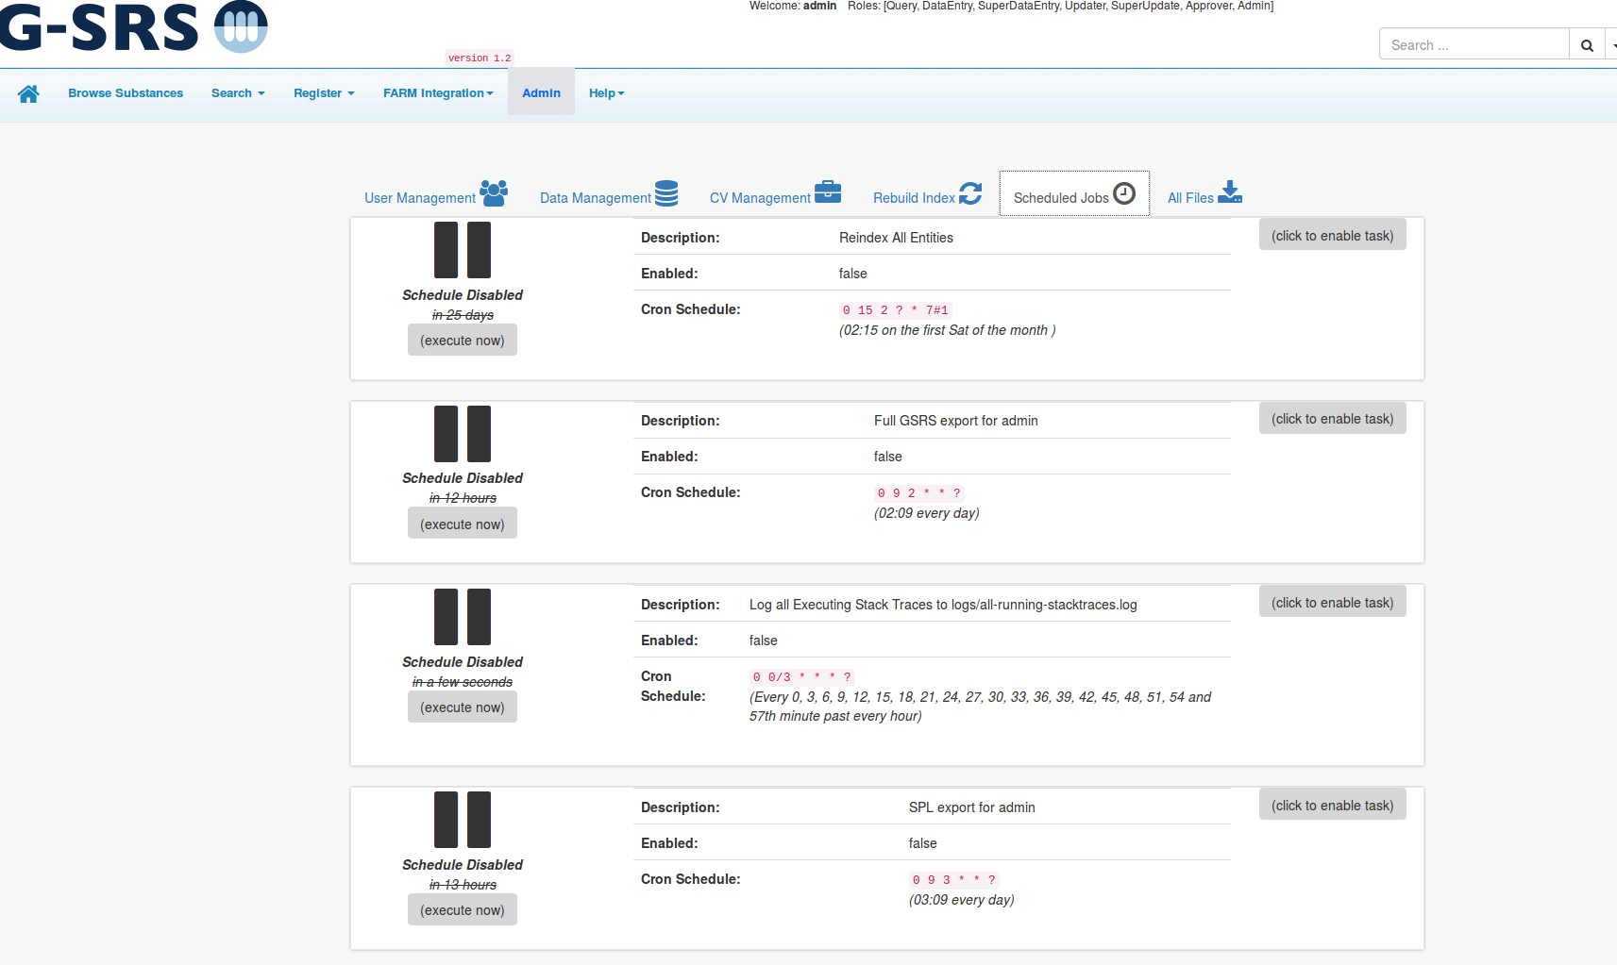
Similar New Plug-in
To make cron like
Tasks
FDA now has custom
Tasks to create
Various exported
Data files every day
Which are consumed
by other FDA teams.

Slide 64
Adding Additional Data to GSRS
Rancho Biosciences has been manually curating additional data about NCATS compounds
Data includes:
Description
PubMed Ids
Who created it (the Originator)
Highest Phase
Synonyms
Mesh, Chembl, DrugBank Ids etc
Condition information
Targets

Slide 65
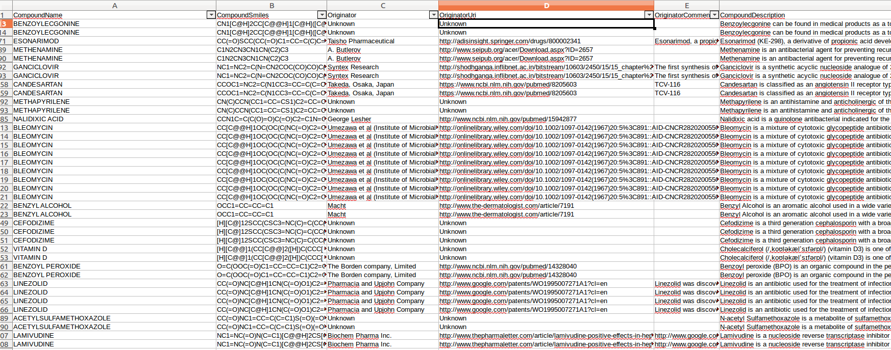
Rancho Curated Compound Data
Over 6,000 manually curated so far

Slide 66
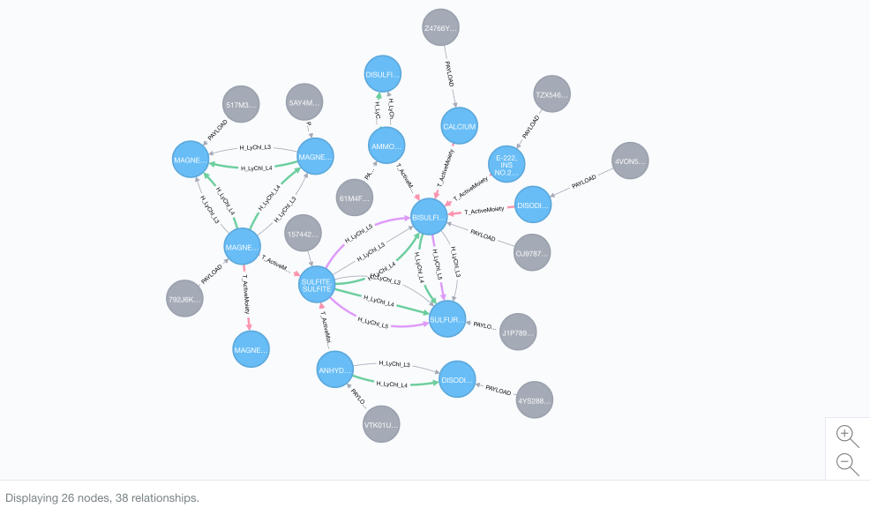
All of this Data is stitched Together
Stitcher Code uses a Neo4j graph database and custom algorithms written By Trung to cluster all the datapoints from disparate data sources

Slide 67
GSRS Support for External Additional Data
Work In Progress - New Plugin to support extra data from external datasources not in the GSRS Database
Currently only supports spreadsheet mappings
New Data is Processed by Lucene Indexes and the UI to:
Enhance user experience
Find new insights that weren’t apparent before
UI geared more towards Researchers than Regulators

Slide 68
Current Ginas Release

Slide 69
Current Ginas Release
Facets
Just basic chemical info +IDs No additional data

Slide 70
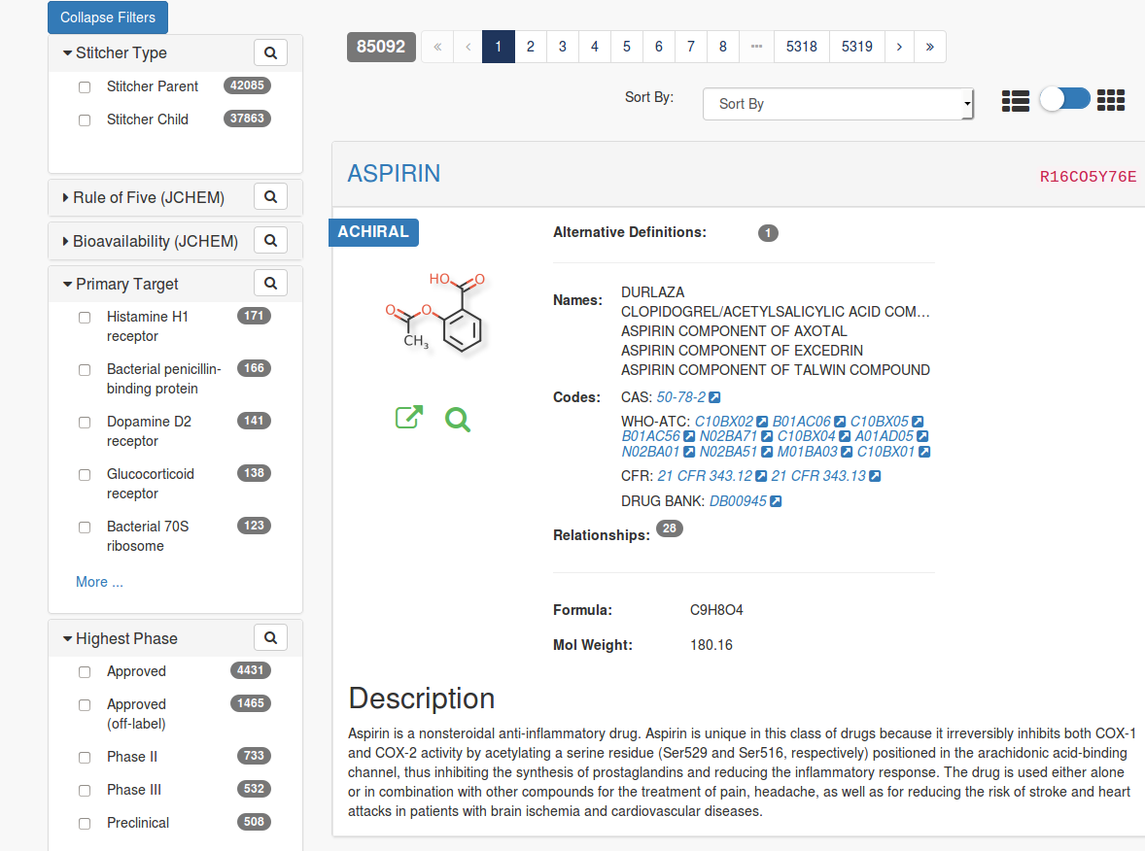
Ginas with
Rancho Stitched Data

Slide 71
Ginas with
Rancho Stitched Data
RanchoTargets
Rancho Phase

Slide 72
GSRS Technical Information
Java Application using Play 2.3 Framework
Lucene Indexes for Text Searches and Faceting
Relational Database using Ebean for ORM
Front End
Play Scala Templates (Twirl)
Javascript - JQuery/ Angular 1/ Angular 2
Back End
Oracle / MySql Relational Database (~ 12 GB of data for 85K Substances)
Lucene Indexes (4.7 GB)

Slide 73
Compound Standardization

Slide 74
Structure Standardization algorithm
Tidy up structure (e.g., fix valence, kekulize)
Break structure into individual components
For each component
Apply “business” rules based on a combination of InChI & FDA guidelines (e.g., neutralize)
Generate a canonical tautomeric form based on a tautomer “force field”
Check if component is a salt or solvent via a lookup table; if yes and salt removal flag is on, remove component.
Fuse components
Postprocessing
(de-) protonation
mobile charges
stereo perception

Slide 75
Hash key generation
Multiple resolution similar to InChI’s and CACTVS/NCI’s hash keys
Four layers
Topology (more coarse than InChI’s /c layer)
Topology + atom labels (tautomer insensitive)
Topology + atom labels + bond order
Full structure
Unlike InChI, hashes for the layers are not independent; they are chained together.
Final hash is encoded as a string over the 32-character alphabet ({A-Z} ∨ {1-9}) \ {E,I,O}
Lexicographically meaningful

Slide 76
Grouping compound bioassay results
Compounds are grouped by parent (sumatriptan, sumatriptan succinate)
Compounds with more than one parent are left alone (mixtures)
Link back to compound/sample structure preserved

Slide 77
Name Standardization approach
Tidy up name (e.g., CAPS, greek, hyphens/spaces)
Allow only one compound per name
Rank by depositor (~lowest CID)
Choosing Preferred Name; from lowest unsalted CID
Nonproprietary names preferred
CAS / IUPAC allowed if have to
Internal codes recognized and used only as last report
Name-Structure conflicts
Assume name is ‘correct’ -> map sample to current standard structure
Send list of conflicts back to depositor for clarification

Slide 78
Beginning of “stuff” presentation

Slide 79
A Brief History of Stuff

Slide 80
13.8 Billion Years ago

Slide 81
13.8 Billion Years ago
(no stuff)

Slide 82
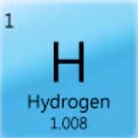
13.7 Billion Years ago
(lots of stuff, but it’s all the same)

Slide 83
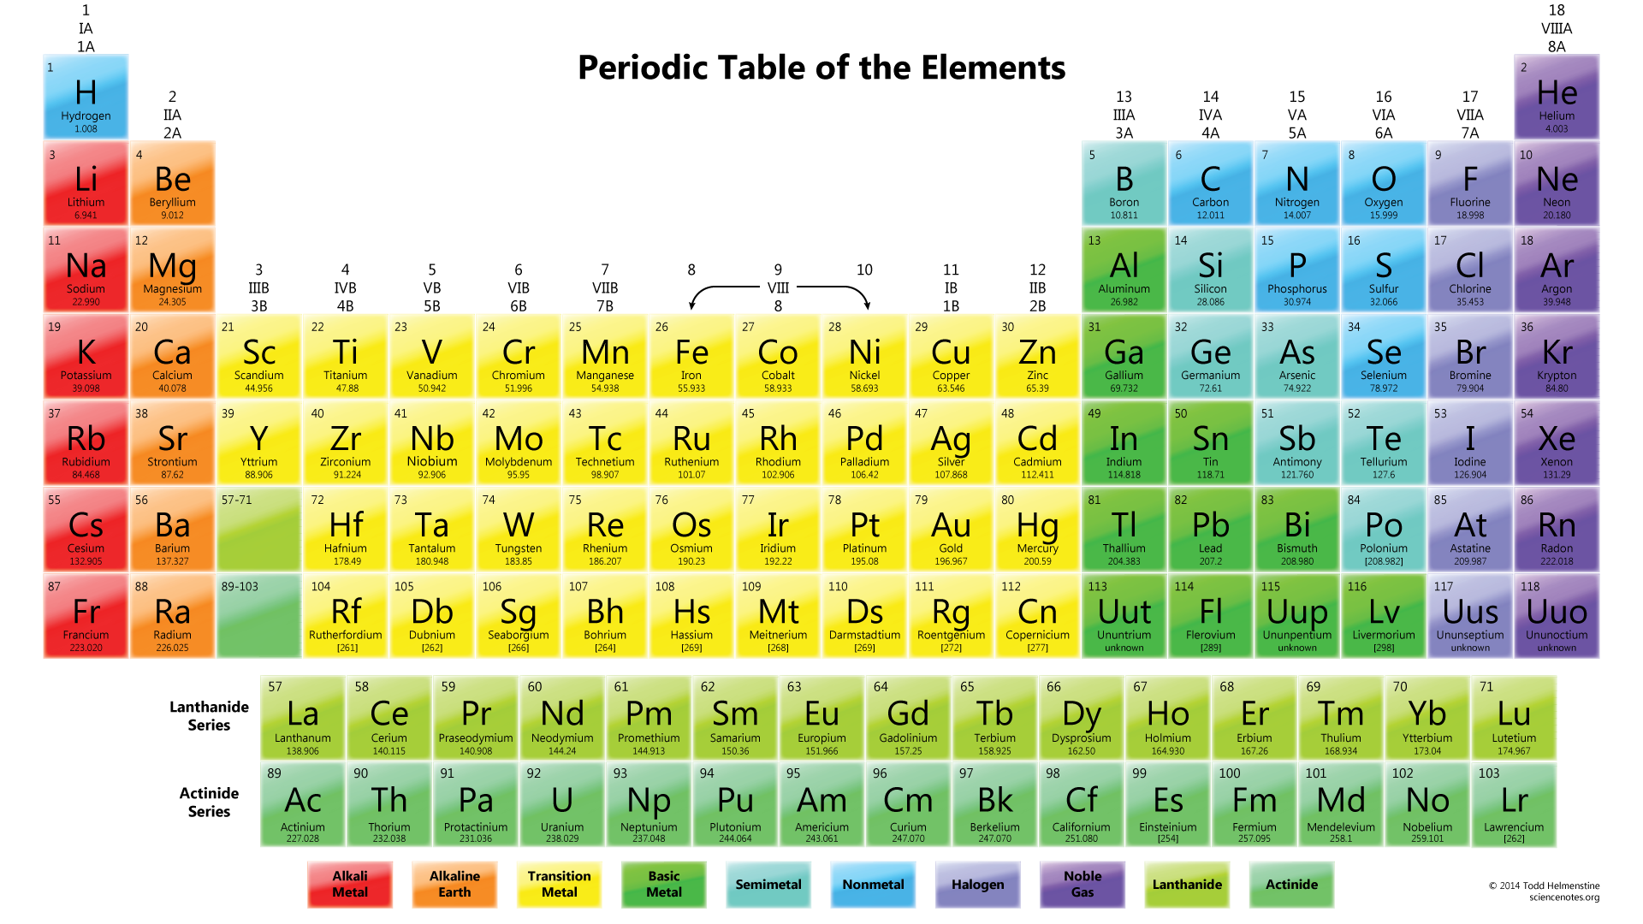
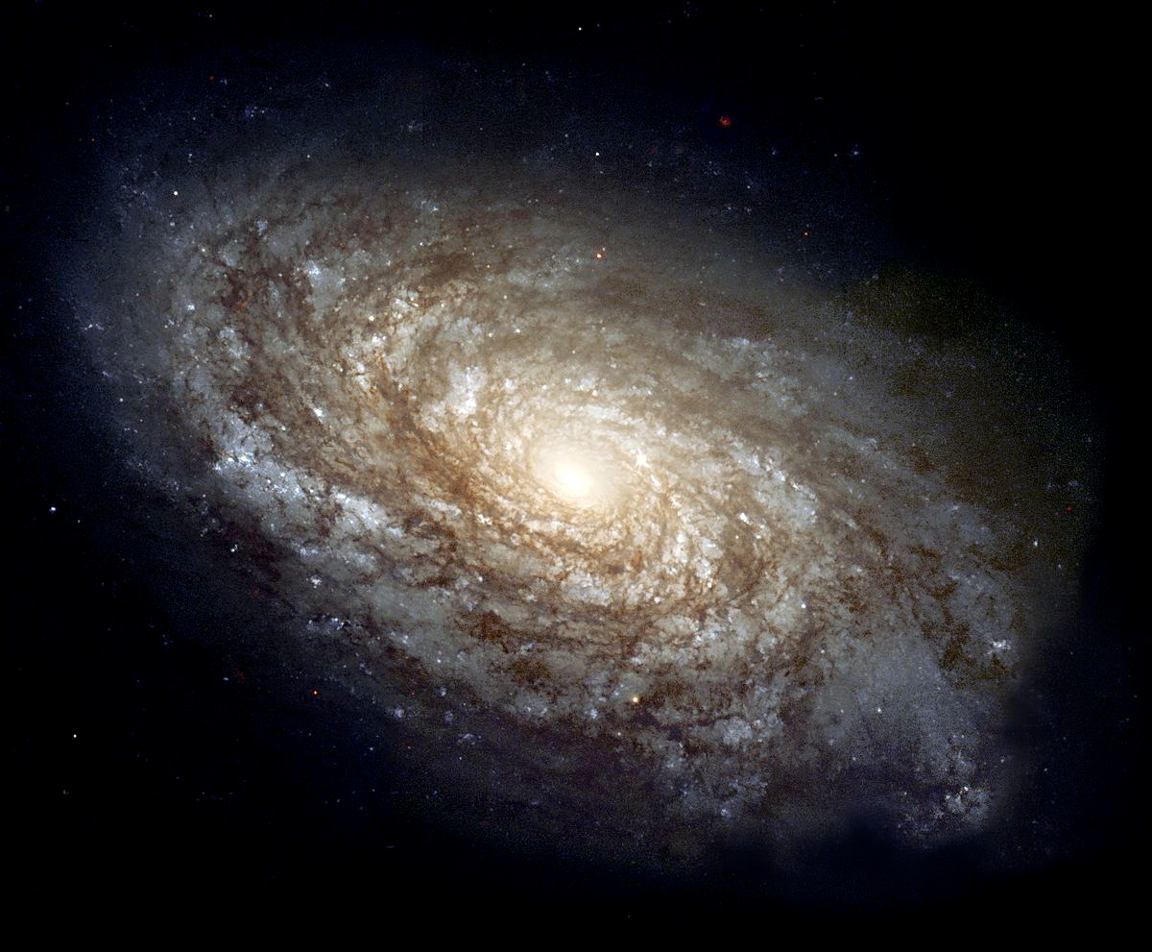
~10 Billion Years ago
(small amounts of very simple stuff)

Slide 84
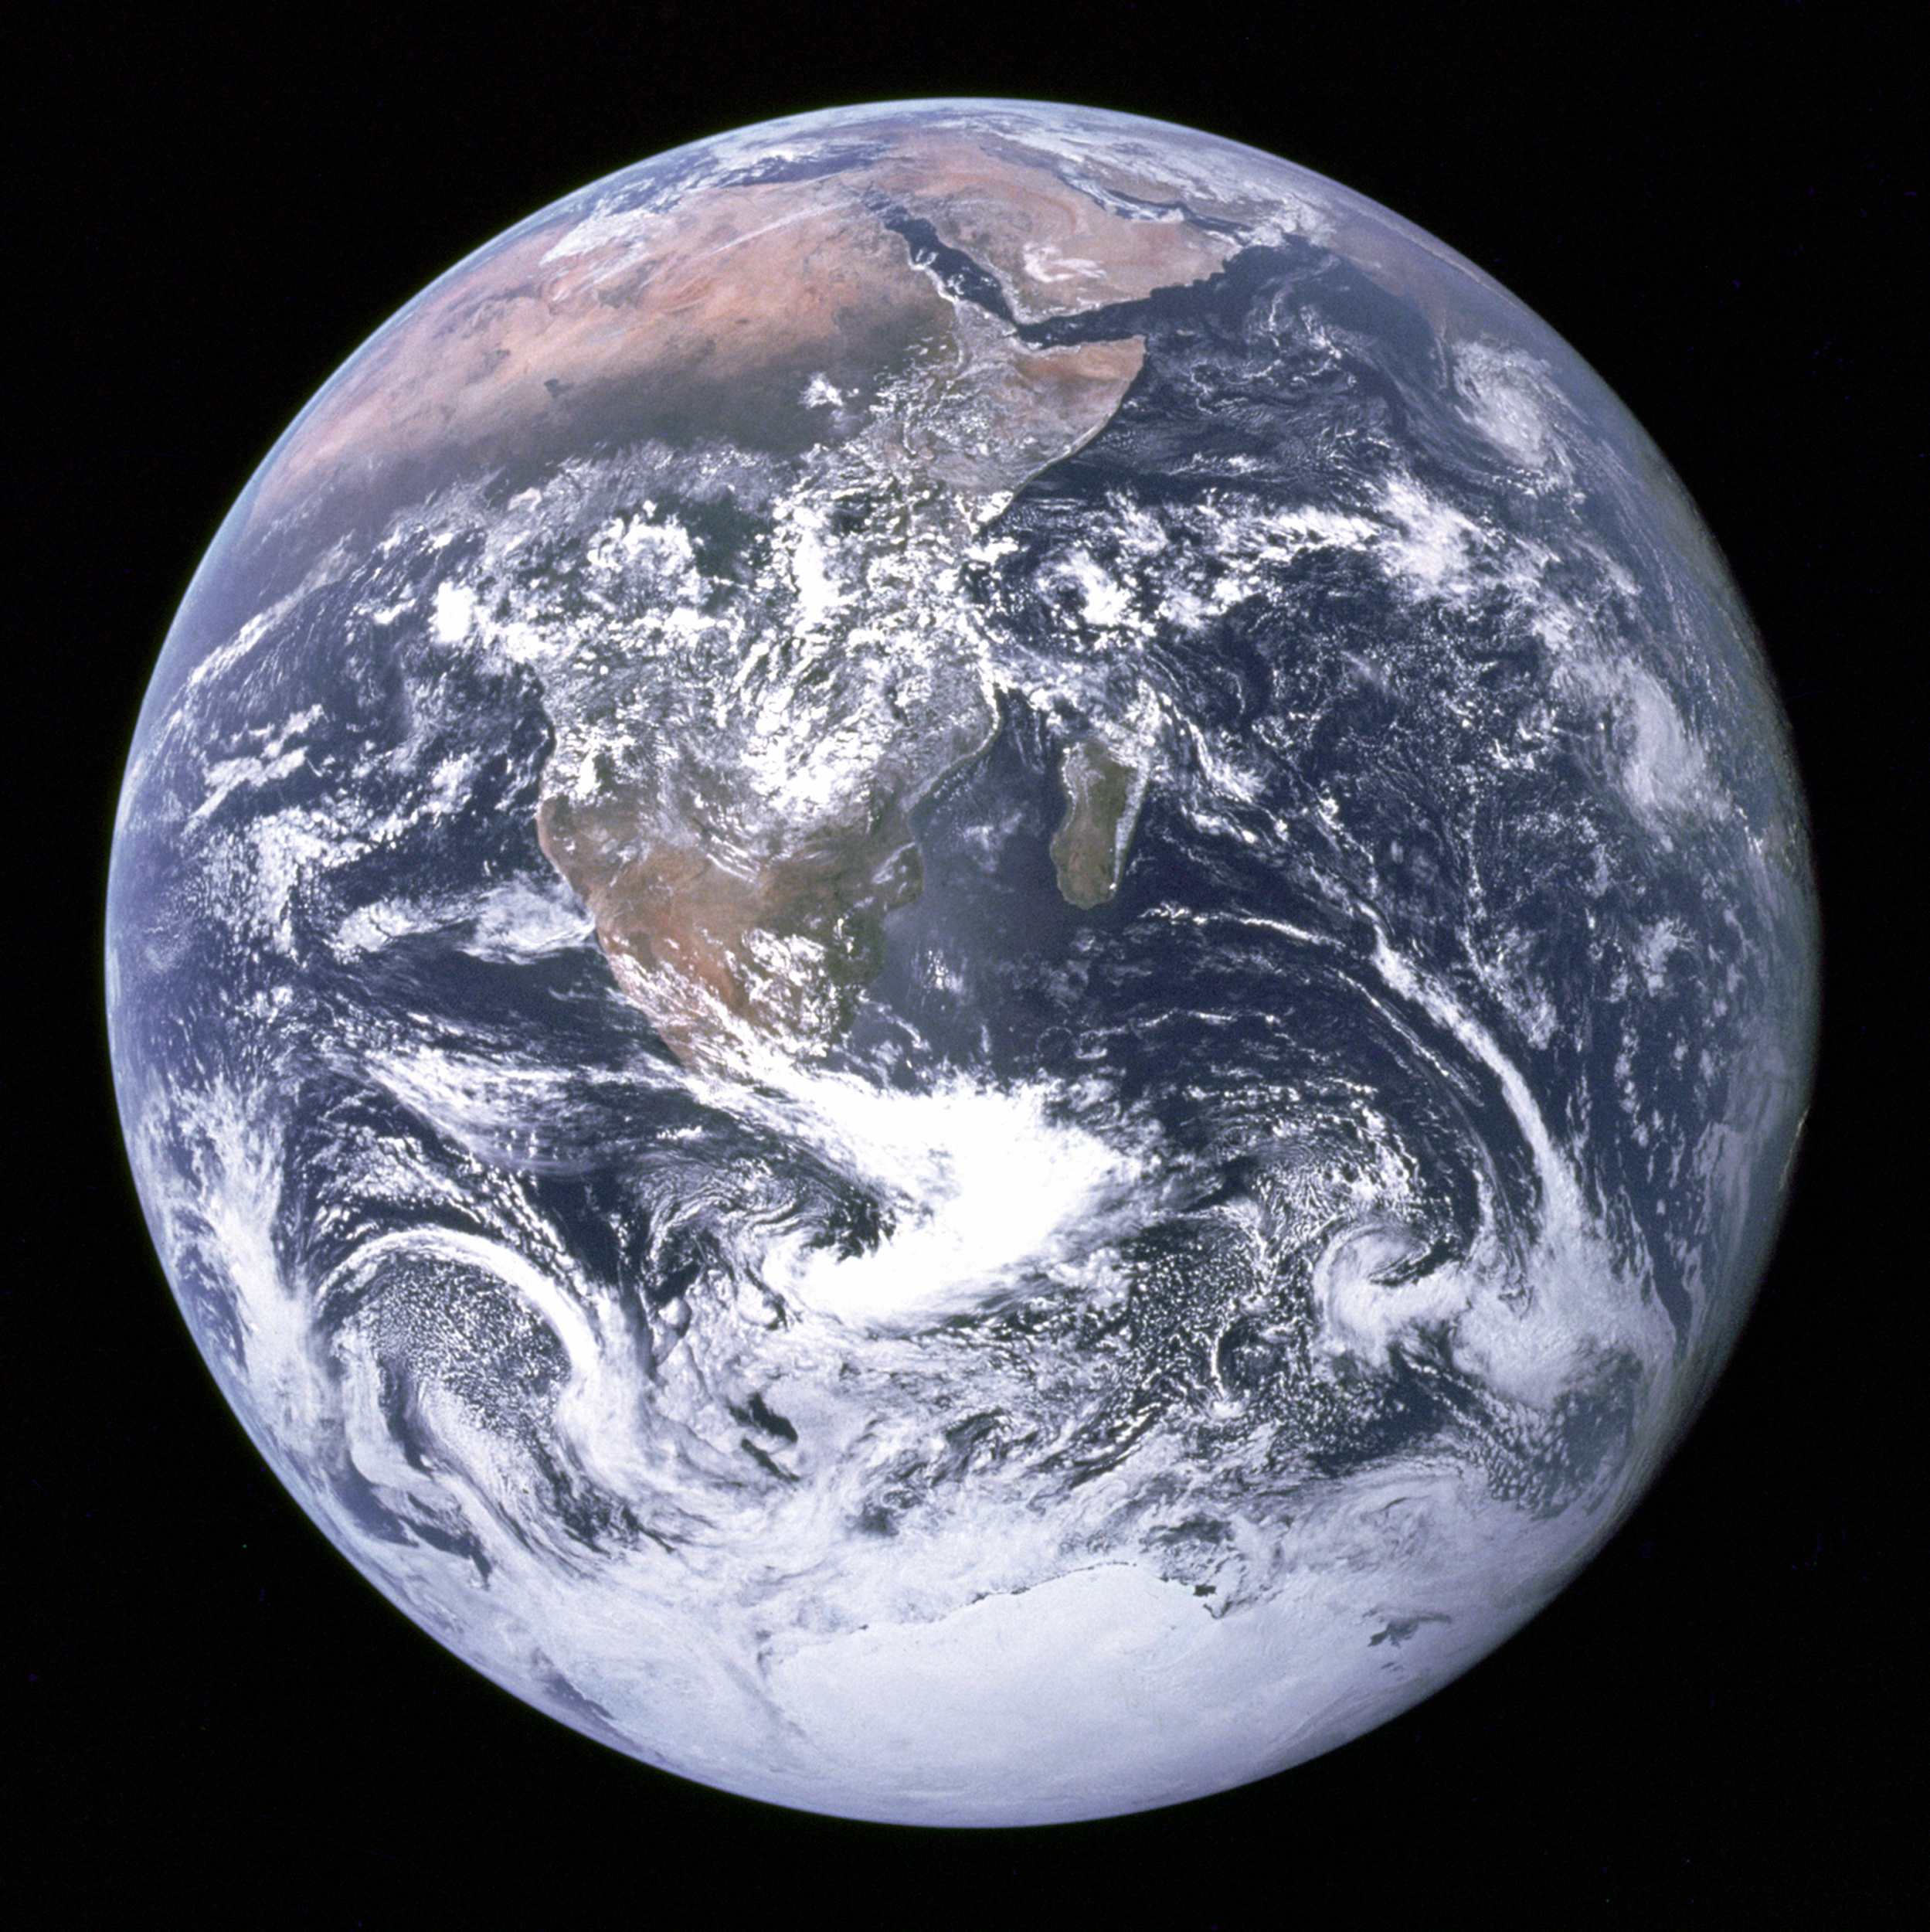
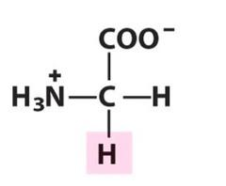
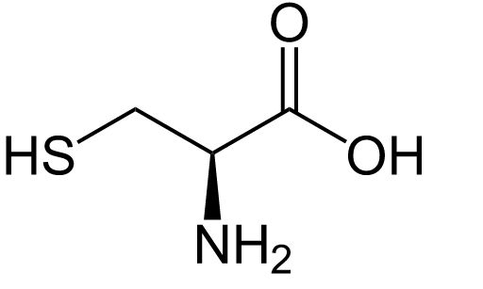
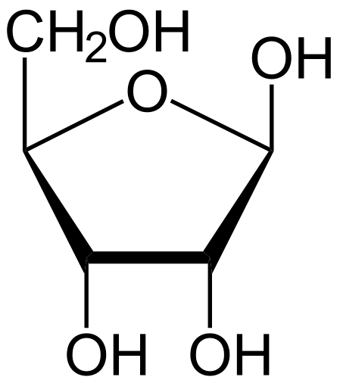
~4 Billion Years ago
(small amounts of simple stuff for life)

Slide 85


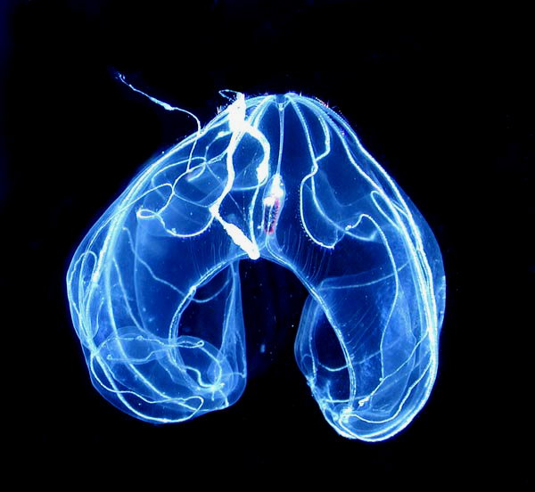
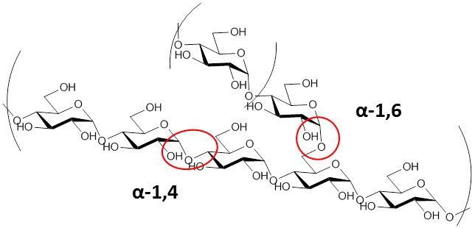
~1 Billion Years ago
(lots of new complicated stuff)

Slide 86
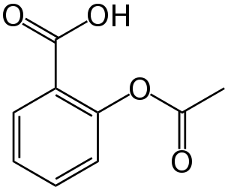
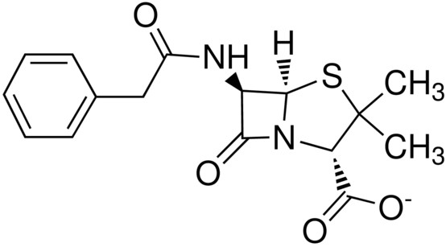

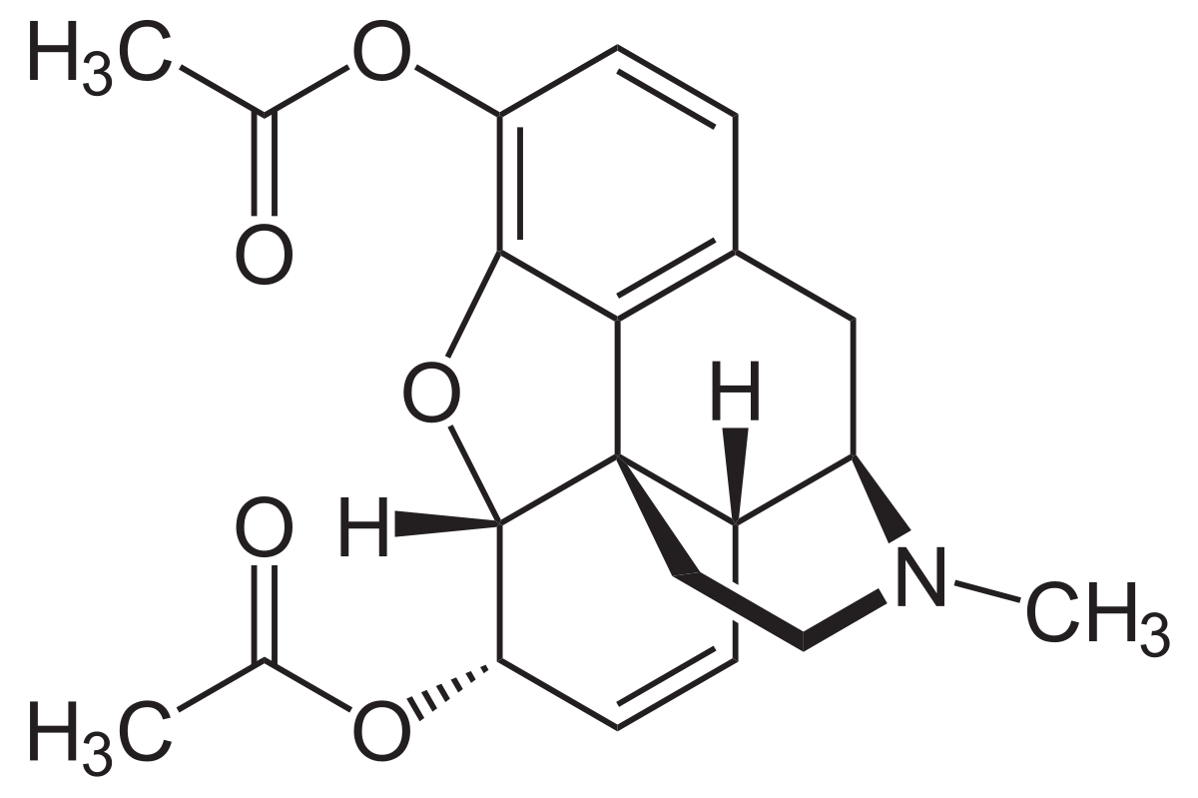
~100 years ago
(we start making lots of new simple stuff)

Slide 87
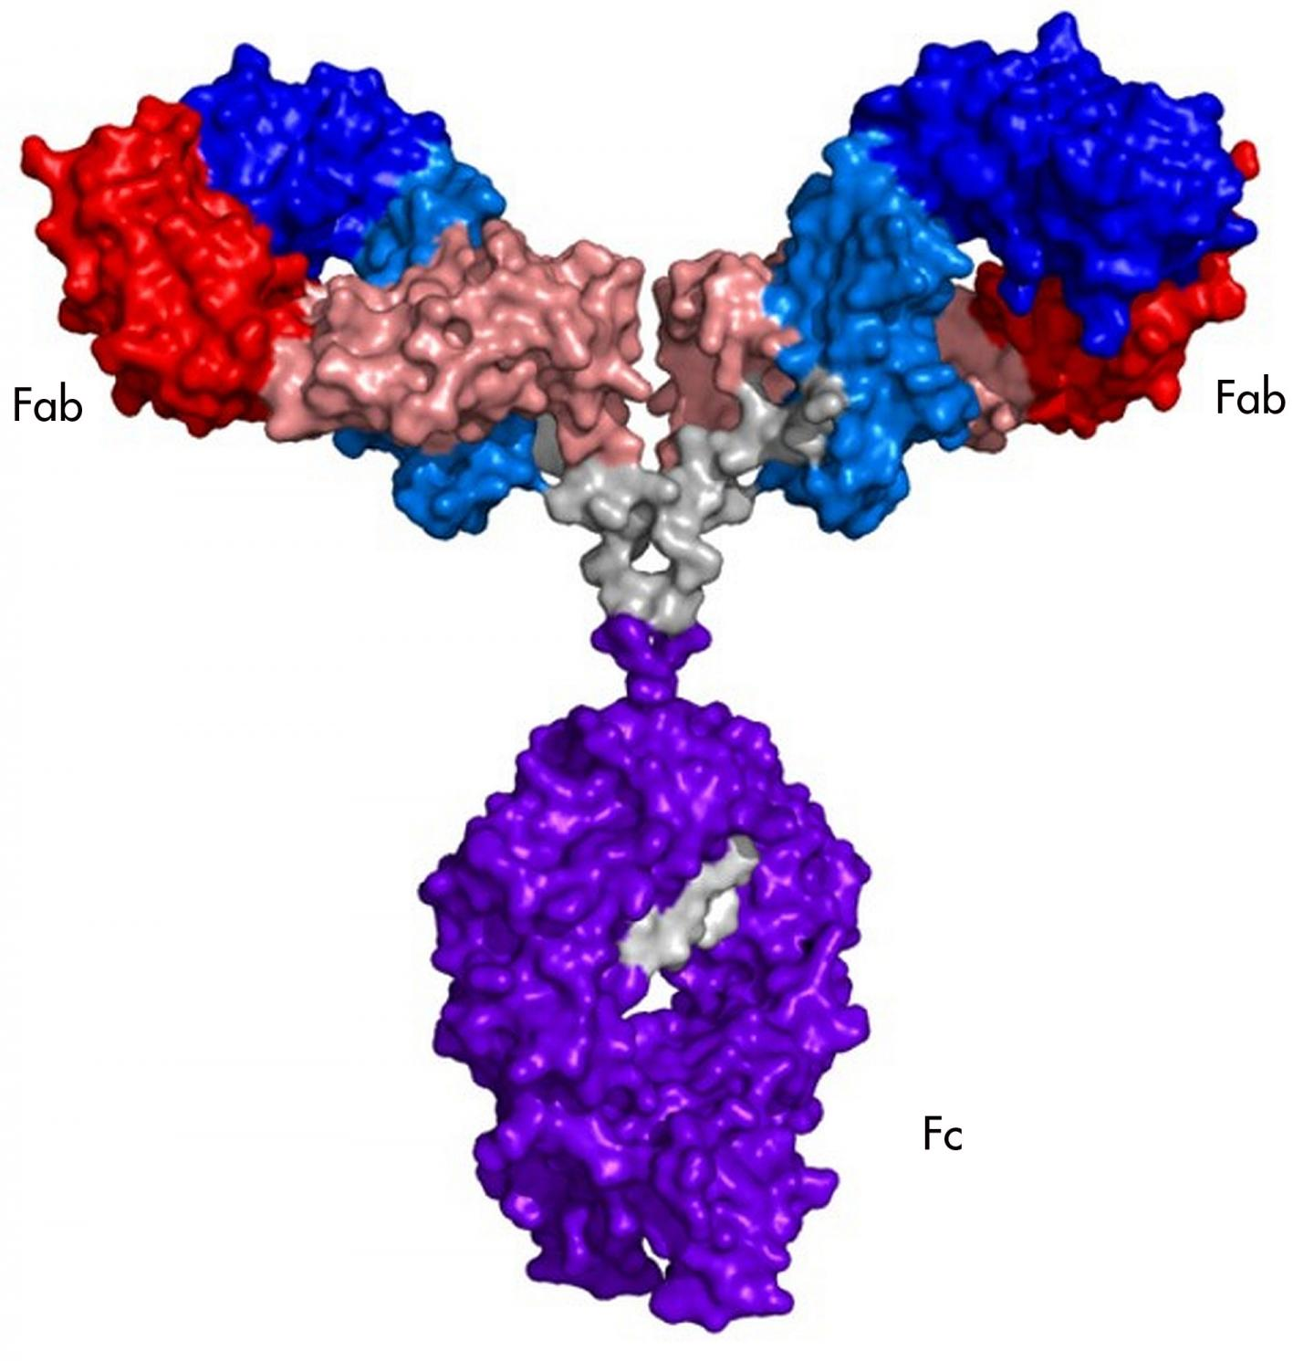
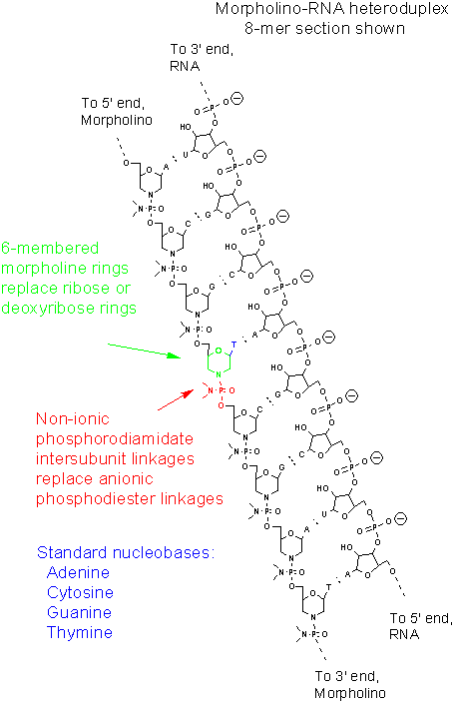
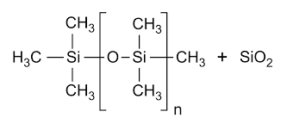
~25 years ago
(we start making lots of new complicated stuff)

Slide 88
Today

Slide 89
Today
(we’ve got to get our stuff together)

Slide 90
How would you make a catalog all the stuff?
Researchers and Regulators need to know
What stuff exists
What it is
Where it’s used
What it does
Whether it does anything else
Notes:
Repurposing, adverse events.

Slide 91
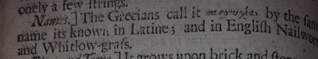
How do you deal with it all?
“Adam” Approach:
Find everything and name it
Bestiaries
Early Pharmacopoeias
Notes:
For years, scientists and proto-scientists have used option 1. They made bestiaries, dictionaries and compendiums that named all the things. They would then describe the things in plain language. Even the atoms were done this way, and it wasn’t until the discovery of the proton that we realized we could do it better.

Slide 92
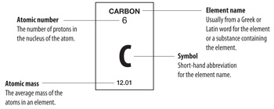
How do you deal with it all?
“Adam” Approach:
Find everything and name it
Bestiaries
Early Pharmacopoeias
“Atom” Approach:
Find what’s important, and systematically describe it
The Periodic Table
International Phonetic Alphabet
Notes:
For years, scientists and proto-scientists have used option 1. They made bestiaries, dictionaries and compendiums that named all the things. They would then describe the things in plain language. Even the elements were done this way, and it wasn’t until the discovery of the proton that we realized we could do it better and simpler. For atoms, (in almost every case) the proton count is all you need to define the element. Everything else follows from that.

Slide 93
Substances at FDA
~1980: “Adam”-based database (Ingredient Dictionary)
2005: Moderately “Atom”-based system (SRS)
2017: Extended “Atom”-based system (GSRS)

Slide 94

Adam Approach: FDA CDER Ingredient Dictionary
Started in the 1980s
Registered active/inactive ingredients found in drugs
Every ingredient had
An identifier (BDNUM)
A Preferred Term
A list of synonyms
Some also had
CAS registry number
Wisswesser Line Notation
~20k ingredients
No rigorous definitions (structure optional)
Many duplicates
Couldn’t do substructure search / similarity
https://drive.google.com/file/d/0BwYl7vhSZYZ7ZTI3NDEyNzctYTAwYy00MzhhLWI1MTMtMTY5OTY0OTM5NmEw/view?usp=sharing
Notes:
The early system for the FDA was essentially option 1. Much like the old print compendiums, it was essentially a set of simple names. There was no way to be sure if 2 substances were exactly the same or not. So company A might call their drug substance “Paracetamol”, while company B would call it “Acetaminophen”. It was their job to manually investigate all available documents to determine if two things were really the same, and they had a lot of problems doing this.

Slide 95
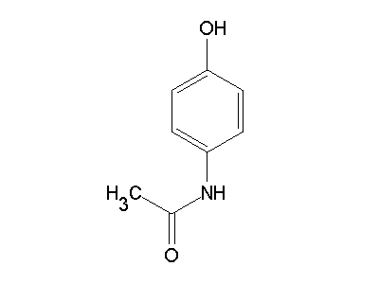


From “Adam” to “Atom”
Small molecules are pretty simple to define rigorously
What does matters:
What atoms you have
How they connect to each other
=
What doesn’t matter:
How you draw it
What color it is
How it smells
How it’s used
What it does
=

Slide 96


A word about storing Chemical Structures
Chemical Structure | WLN | Smiles | InChI
 | 1O9 | COCCCCCCCCC | InChI=1S/C10H22O/c1-3-4-5-6-7-8-9-10-11-2/h3-10H2,1-2H3
 | T56 BMJ | N1C=CC2=C1C=CC=C2 | InChI=1S/C8H7N/c1-2-4-8-7(3-1)5-6-9-8/h1-6,9H
 | 1VOR BVQ | CC(=O)OC1=C(C=CC=C1)C(O)=O | InChI=1S/C9H8O4/c1-6(10)13-8-5-3-2-4-7(8)9(11)12/h2-5H,1H3,(H,11,12)
Notes:
Look at the differences. Nobody uses WLN anymore, but the FDA and other regulatory industries used to. I have a book that is 230 pages to describe wisswesser line notation. It takes about 20 pages to fully understand how to read a WLN string, and then 210 pages to learn how to write one “canonically”. That is, it’s pretty easy for someone to give you a readable WLN string for their chemical structure. It’s pretty hard This is a classic problem in chemoinformatics, closely tied to the general graph isomorphism problem of general computer science.

Slide 97
Maybe a note about Lychi?

